Slide 1
Early Years Transitions
Specialist Advisory Teachers
Early Years SEND Transition

Slide 2
Aims of the session
Develop an awareness of how children with SEND may experience transitions
Consider the key elements that make a successful transition
Explore strategies to support children with additional needs to transition to school successfully

Slide 3
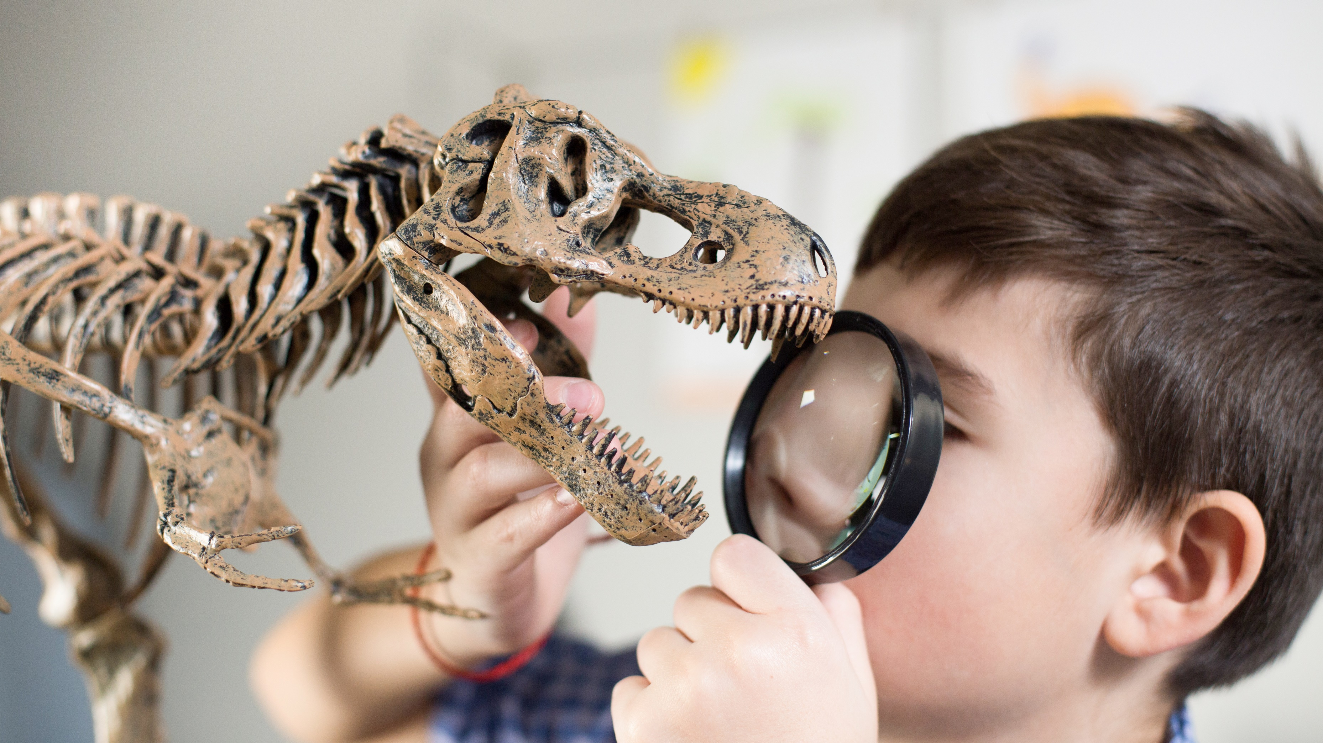
The Unique child
‘ Transition processes that are tailored to meet the needs of the unique child are more effective than a ‘one size fits all’ process.’
Birth to Five Matters (2021)
We need to understand the starting points for every child, regardless of their chronological age, and plan accordingly.

Slide 4
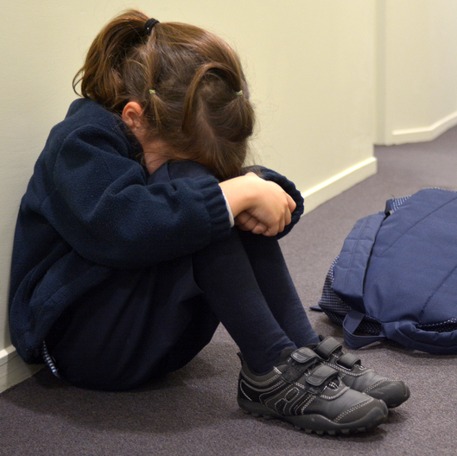
Starting School
What might help a child with SEND experience a successful transition to school?

Slide 5
Key elements for a successful transition
establishing relationships
sharing information
visits
creating continuities
preparation in the setting
training and support
settling in and follow up

Slide 6
Supported Transition Meeting

Slide 7
Activity
List all the potential transitions a child will make during their day at school.

Slide 8
Daily routines and transitions
Think about which experiences are essential as each one necessitates a transition.
There is no requirement within the EYFS for children to participate in Assemblies, PE or whole school breaktimes.
We need to be clear about what the benefits are for the children of these experiences. What are the challenges?
Some children may be ready for these experiences earlier than others.
Participation in whole school or more structured experiences should evolve over time when the children are comfortable with the classroom routine and environment.

Slide 9
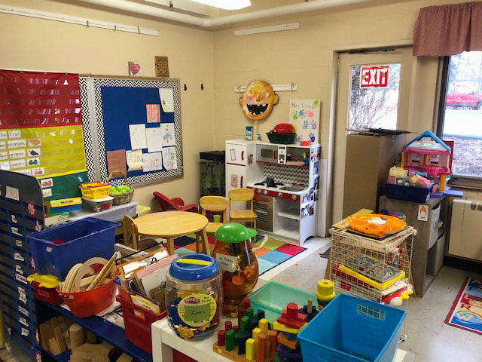
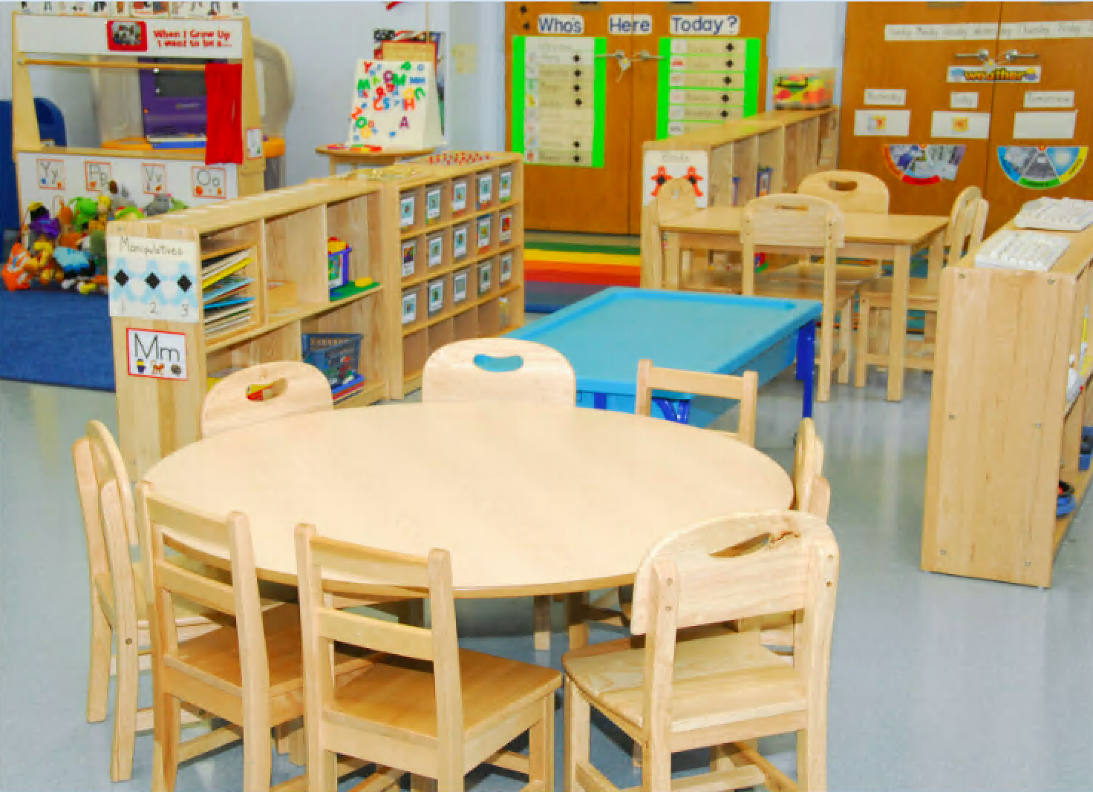
Which Classroom is most conducive to learning?

Slide 10
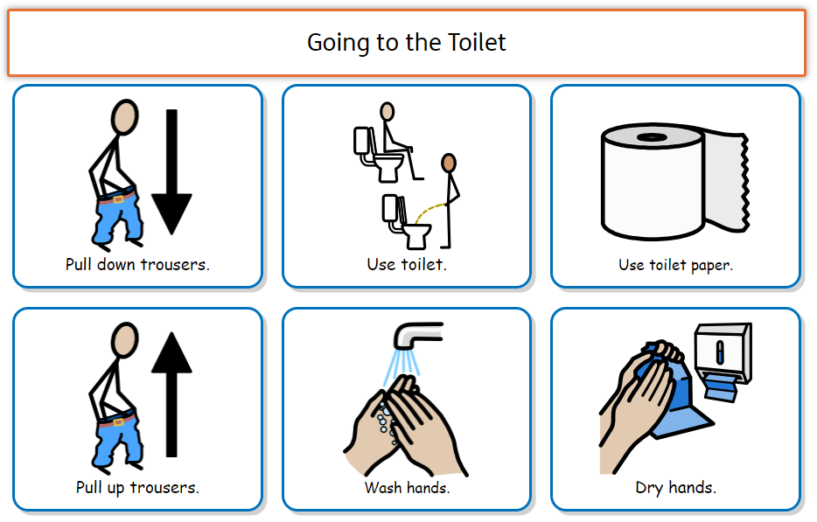
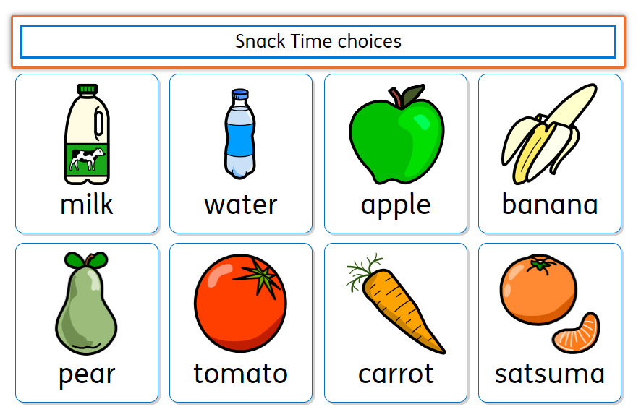
The importance of Visuals
Visual timetable
Lanyard symbols for all staff
Sequences – every day routines e.g. hand washing, toilet etc
Choice boards

Slide 11
Staffing
Consider the employment/deployment of staff to ensure individual needs can be met.
It may be a case of putting in a higher level of support to begin with and then reducing it over time.
A flexible approach works best in order to respond to individual needs.
Notes:
1 minute

Slide 12
Toileting
Some children may not be able to attend to their own personal care needs or be fully toilet trained on entry to school.
The Equality Act 2010 states that schools must not discriminate against or disadvantage disabled children or those with special educational needs. A delay in achieving continence - or not being toilet trained - is considered a disability. It is therefore not acceptable for a school to refuse or delay admission to children who are not yet continent.
There is no legal requirement for two members of staff to be present when changing a child.
The ERIC Website has a range of useful resources for parents and professionals, including a ‘Guide for children with Additional Needs’.
Children with additional needs - ERIC
Notes:
2 minutes Guidance from FAQ on ERIC Website: There is no legal requirement for two members of staff to be present, so schools should not refuse to clean a child if only one member of staff is available to leave the classroom.
For safeguarding reasons, staff who help with intimate care should make sure another member of staff is aware they are going to change a child and is in the vicinity and visible or audible ((see page 14 of the 'Guidance for safer working practice for those working with children and young people in education settings', 2015)
It is good practice to ensure that all aspects of continence care in school are documented in advance, for instance using an individual health care plan making sure parental consent is obtained for named carers to meet the child's needs.
The guidance also states that "intimate or personal care procedures should not involve more than one member of staff unless the pupil's care plan specifies the reason for this."
So not only is there no need for two members of staff to be present, it is in fact discouraged unless the child needs two members of staff.
You’ve got some great case studies that you could share here about how schools successfully overcame problems with toileting this year? Also worth mentioning about how to manage the practicalities of space etc and that most children ‘in nappies’ will actually be in pull-ups? Also, about how they can support parents with toilet training at home.

Slide 13
For the first half of Autumn term the focus should be on:
Building positive, trusting relationships
Helping children feel safe and secure in their new school environment
Establishing predictable daily routines
Supporting children to develop in the prime areas

Slide 14
A successful transition to school
Parents and staff feel confident they have a good understanding of the children’s needs and how best to meet them.
Staff have a positive, open and honest relationship with parents.
School staff know which agencies to consult for support and advice.
Children are happy, settled and have positive relationships with staff so they can make progress in all areas of learning.

Slide 15
EYSAT Referrals
If you would like to refer children to our service in the Autumn Term, once they have started school, follow the link to our information page on Services for Schools
Specialist Advisory Teachers for Early Years SEND Transition | West Sussex Services for Schools
Here you will find the schools referral form, a useful flow chart explaining our referral process, our contact details and information for parents.

Slide 16
Any Questions?

Slide 17
Actions
Think about one or two actions you are going to take away from today’s session that you can implement at your school to support transition for children with additional needs.
Be mindful to see transition through the child’s eyes.
Notes:
1 minute
Thinking about the chn with SEND that are coming in to your school this September, what things might be useful to take away from today’s training that you could implement.
Could they write on post it note or evaluation so we can use?

Slide 18
Future Training Courses
We are offering two new training courses in the Autumn Term 2023:
Phonics for All – Adapting Phonics in the Reception class for children with SEND
Three dates in September – two in person and one online (all twilight sessions)
Why use visuals in the Reception class?
Three dates in October – two in person and one online (all twilight sessions)
Training & Events | West Sussex Services for Schools
Notes:
To book events follow link to Services for schools training and Events – course are free and aimed at Reception teachers.

Slide 19
Links to Guidance Materials
For specific need type ‘strategies to support transition’ utilise the West Sussex Autism and Social Communication Team (ASCT) and Learning and Behaviour Advisory Teams (LBAT) guidance ‘Planning for Positive Transitions from Early Years Settings into School’ – ‘A Best Practice Guide for Settings and Schools’. (Link below)
https://schools.local-offer.org/wp-content/uploads/2020/07/Booklet-for-supporting-EY-Transitions.pdf
For the West Sussex Ordinarily Available Inclusive Practice document – Annex Section 2 EYFS
Ordinarily Available Inclusive Practice (OAIP) | Tools for schools (local-offer

Slide 20
Thank you for joining us.

