Slide 1


Speech, Language and Communication Progression Tools
Sally Kean – Children’s Commissioning Manager, West Sussex
Rachael Lee – Designated Clinical Officer for SEND, West Sussex
Speech and Language Therapists
Sally.kean@nhs.net

Slide 2
Did you know..?:
In the UK, over 1 million children and young people - that's 2 - 3 in every UK classroom - have some form of long term and persistent speech, language and communication difficulty. This can affect them early, severely and for life.
50-90% of children with persistent speech, language and communication difficulties go on to have reading difficulties
In areas of poverty, over 50% of children are starting school with delayed communication skills. Their speech may be unclear, vocabulary is smaller, sentences are shorter and they are able to understand only simple instructions.

Slide 3
Did you also know..?
More than 50% of pupils excluded from school have unidentified language difficulties
Around 65% of individuals in the Youth Justice System have some form of communication difficulty
Up to 75% of secondary age pupils in certain areas of the UK have limited language
In one study 88% of unemployed young men were found to have language difficulties
Ref. ICAN/ RCSLT
Notes:
SLCN represents one of the most prevalent disabilities in childhood. ICAN states that there is no decline in prevalence over the 0-16 age range. At any one time you are likely to have several students in your class with SLCN.
SLCN in adolescence associated with poor academic performance, social and emotional difficulties and poor peer relationships.
Clear link between communication difficulty and criminal activity- often unrecognised.
Figures taken from Speech, Language and Communication in Secondary Aged pupils ICAN Talk Series- Issue 10) and RCSLT
Elliott, N (2009) An exploration of the communication skills of unemployed young men RCSLT conference presentation: Locked Up and Locked
Out: Communication is the Key. Cardiff

Slide 4
What are the speech, language and communication progression tools?
Support school staff to identify students with possible SLCNs
Enable school staff to track progression over time
Based on theoretical information about typical language development
Notes:
Universally Speaking Booklets- for more information
Speech and language difficulties represent the most common childhood disability.
We know that some children can have SLC needs that affect their ability to listen understand and express themselves, which can impact on their ability to learn and socialise with others.
However it’s not always easy to identify a difficulty or judge how well children and young people are progressing with these skills.
The Communication Trust has developed these tools to help this process- they are a coalition of nearly 50 voluntary and community organisations with expertise in SLC. They aim to use this knowledge to support the children’s workforce and commissioners to ensure all children’s SLC needs are met

Slide 5
How were the tools developed?
Specialists and mainstream school staff
Tested on children and young people
Results and feedback refined for final version of tools
Notes:
Developed by specialists in speech, language and communication in collaboration with mainstream teachers, TAs, SENCos and school leadership teams. Tested on a large number of mainstream schools and settings on a range of children and young people.
They are not a diagnostic tool- not designed to replace a detailed SLT assessment that some children will need
They can be used to provide information to help decide whether children would benefit form a targeted intervention or whether they need further specialist assessment and support.
There are 8 Tools: Age 3, 4, 5-6, 7-8, 9-10, 11-12, 13-14, 16-18 years, cost £30 per tool, discount for pack

Slide 6
Graduated approach in the classroom
What? | How? | Next Steps?
1. Look at all the pupils | Top tips for spotting SLCN (Misunderstood) | Identify the pupils you are worried about.
2. Look at these pupils in a bit more detail | Use universally speaking booklet. Are they doing what they should be? | Try some ways to check it out in class. Try out some classroom approaches to support SLC.
3. Look at the pupils still causing concern. | Use the progression tool | This will tell you wave 2 or wave 3
Notes:
Talk about the “balanced system”
Can use as a whole school screen
Show Misunderstood book and show top tips sections

Slide 7


How do I use the tools?
Questions to complete 1:1 with child or young person
Adult completes observation section
Notes:
2 main sections- ‘Questions’ (completed in one session on 1:1 with child- approx. 30 mins) and ‘Observations’ (completed by member of staff who knows child well)
Each Tool comes with colour ‘Reference’ book (containing information, questions/ observation sections for reference , scoring guidance, Profile charts) and black and white ‘Scoring’ form, some have additional picture cards

Slide 8
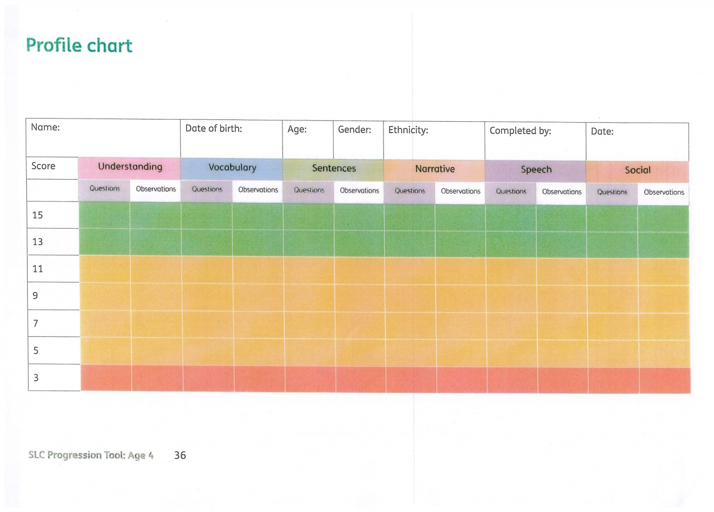
Profile Chart
Notes:
Once scored, the Profile chart is completed for each child
This can help identify the level of support needed for the child

Slide 9
What do I do with the results?
Check appropriate universal strategies are in place in the classroom for all children.
Targeted small group work. Published resources also available.
Discuss at termly planning meeting with SLT.
Notes:
Children with pure speech sound difficulties should be discussed straight away with SLT.
Refer to social communication Team if only area of difficulty is social communication.

Slide 10
Video
How to use the Progression Tools
https://youtu.be/5V6uIuil0b4

Slide 11
Top Tips
Photocopy
Read Practical steps
Find quiet space
Record exactly what child says
Notes:
Share copies of top tips posters

Slide 12
How do the tools link to the National Curriculum
Primary
Essential to help schools understand what progression in spoken language should look like from years 1 to 6 so they can develop their own descriptors about progression for each year group. Could be used to show evidence of progress.
Secondary
Areas assessed relate well to the objectives for Spoken English at Key stage 3 and 4.
Understanding vs speaking
The tools focus more on understanding of language than NC programmes of study do.
Notes:
In line with the SEND Code of Practice 2014, the Progression Tools can support schools with:
Identifying and monitoring pupils who require SEN support
Encouraging teaching and support staff to be responsible for the SEN needs of the children in their class
Identifying and supporting staff training needs
Developing a whole school approach to SEND

Slide 13
Further Support www.speechandlanguage.org.uk
Reminder/Refresher
Training Video
Getting the most out of the tools
Top tips – Primary and Secondary
Ages and stages of communication development
Universally Speaking Booklets

Slide 14
Free resources:
Electronic versions of scoring, answer sheets and profile will be shared after training.
Downloadable
    Misunderstood https://councilfordisabledchildren.org.uk/sites/default/files/uploads/files/misunderstood-supporting-children-and-young-people-with-speech-language-and-communications-needs.pdf
    Don’t Get Me Wrong https://issuu.com/thecommunicationtrust/docs/dontgetmewrong
    Universally Speaking (birth-5, 5-11, 11-18) https://speechandlanguage.org.uk/shop-for-educators/
    Let’s Talk About It https://issuu.com/thecommunicationtrust/docs/lets_talk_about_it
    Top Tips (Primary/Secondary) https://speechandlanguage.org.uk/talking-point/for-professionals/primary-and-secondary-school-teachers/
    Frequently Asked Questions https://speechandlanguage.org.uk/talking-point/for-professionals/professionals-faqs/
Staff training CPD opportunities https://speechandlanguage.org.uk/talking-point/for-professionals/the-communication-trust/
Notes:
Misunderstood explains what speech, language and communication needs are and includes advice and guidance on how to support communication development.
Don’t Get Me Wrong looks at speech, language and communication needs in children and young people. It is full of useful information and advice which you can use in your setting. It is ideal for SENCOs and teaching assistants
Universally Speaking - is a series of booklets for anyone who works with children and young people. The booklets show where children should be with their communication skills at any given age.
Let’s Talk About It - The impact that speech, language and communication needs (SLCN) can have for children and young people on learning and attainment, and on social, emotional development and behaviour

Slide 15
Targeted Resource List:
 | Understanding | Vocabulary | Sentences | Narrative | Speech | Social
EYFS | School Start (Speechmark) Reception Narrative pack (BSP) Time to Talk (LDA) | School Start (Speechmark) Reception Narrative Pack (BSP) Time to Talk (LDA) | Reception Narrative pack (BSP) | Reception Narrative pack (BSP) Time to Talk (LDA) | School Start (Speechmark) Time for Sounds BSP (Nursery or Reception pack)) | School Start (Speechmark) Reception Narrative pack (BSP) Time to Talk (LDA)
KS1 | KS1 Narrative pack (BSP) | KS1 Narrative pack (BSP) Robust vocabulary Word Aware (Speechmark) | KS1 Narrative pack (BSP) | KS1 Narrative pack (BSP) | Time for Sounds (Reception) | KS1 Narrative pack (BSP) Lego Therapy Socially Speaking (LDA)
Notes:
Universal and Targeted Training Robust, Narrative, Total Communication, Speech Sounds, LSA Core Primary, LSA Secondary

Slide 16
 | Understanding and verbal reasoning | Understanding and using vocabulary | Sentence structure and narrative | Social interaction
KS2 | KS2 Narrative pack (BSP) Active listening for Active Learning (Q Ed publications) Reading Between the Lines (Speechmark) Think About It/ Speech Bubbles (BSP) Language for Thinking (Speechmark) | KS2 Narrative pack (BSP) Robust vocabulary Word Aware (Speechmark) Rhodes to Language (STASS publications) | KS2 Narrative pack (BSP) Rhodes to Language (STASS publications) | KS2 Narrative pack (BSP) Lego Therapy Socially Speaking (LDA) Talkabout Activities (Speechmark)
KS3/4 | Active listening for Active Learning (Q Ed publications) Reading Between the Lines (Speechmark) Think About It (BSP) Language for Thinking (Speechmark) | Robust Vocabulary Rhodes to Language (STASS publications) Vocabulary Enrichment Programme (Speechmark) | Secondary Talk (templates) (BSP) KS2 Narrative pack (BSP) Narrative Intervention Programme (Speechmark) | Talkabout for Teenagers (Speechmark) Lego Therapy

Slide 17
Resource to download for interventions
Word Aware https://youtu.be/G-v61HNtG4c
More detailed Progression Tools video
  • https://speechandlanguage.org.uk/shop-for-educators/progression-tools-from-the-communication-trust-for-primary-years-set/
  • https://speechandlanguage.org.uk/shop-for-educators/progression-tools-from-the-communication-trust-for-secondary-years-set/

Slide 18
General SLCN resources
Elklan Language Builders
  5-11, 11-16
  Verbal ASD
Elklan Let’s Talk
  5-11, 10-14

Slide 19
Any Questions?

Slide 20
Principles of running groups
Pick the group carefully
Think about the seating
Keep the length short
Make a visual timetable, make it active
Active involvement
Visuals throughout

Slide 21
Vocabulary groups
Children with vocabulary difficulties need:
  Strengthening general knowledge of the word (semantic)
    Description, function, location, category, similarity, association
  Understanding the structure of the word (phonetic)
    Length, syllables, rhyme, initial sounds, other sounds
  Frequent repetition across different context/activities
Word maps are a useful visual support

Slide 22
Social skills groups
Useful resources: Talkabout, Socially Speaking
Twinkl
https://www.theottoolbox.com/social-skills-checklist/

Slide 23
Narrative groups
BSP narrative packs
Narrative grids
  Attribute grids
  Spidergrammes

Slide 24
Emotional literacy
The Bear Cards
Emotion monsters
Zones of Regulation

Slide 25
Any Questions?

