Slide 1
‘Are We Listening?’ Co-production with Parent Carers

Slide 2
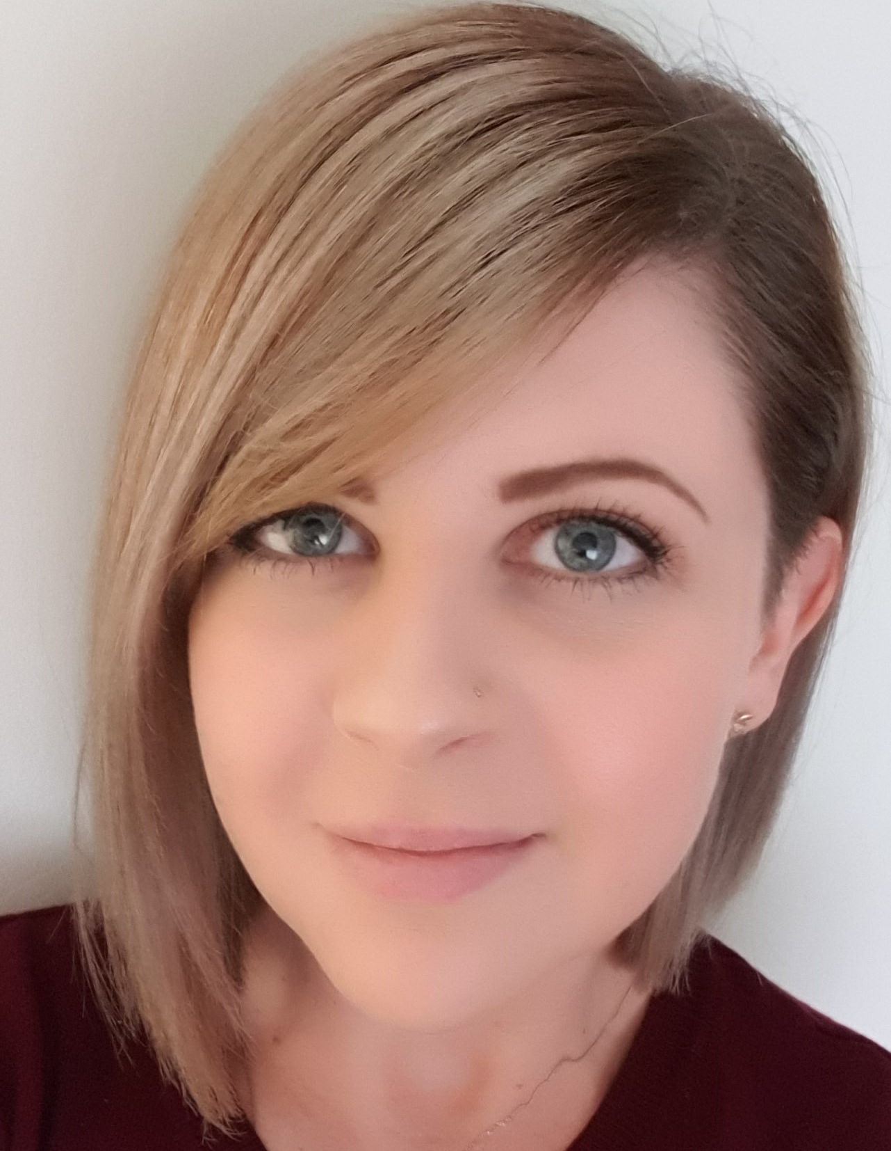
Welcome and Introductions
Hannah Torr
Gemma Humphrey

Slide 3
Aims
To explore ways of gathering parent carer views
To understand why co-production is important
To consider barriers to effective home-school partnerships

Slide 4
SEND Code of Practice 2015
Overarching principle of participation of CYP and their parents in decision-making
Section 6 p104, 6.64 – 6.71 Involving parents and pupils in planning and reviewing progress
https://assets.publishing.service.gov.uk/government/uploads/system/uploads/attachment_data/file/398815/SEND_Code_of_Practice_January_2015.pdf

Slide 5
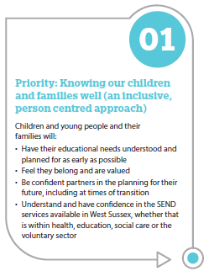
We value Pupil and Parent Carer Views in West Sussex
Notes:
IDENTITY and language choices
Parents
Carers
Parent carers
Guardians
IDENTITY of your child – preferred terminology
Child with SEND / SEND child
Autistic / ASD / ASC
Neurodiverse
Pupil / student / young person
Special needs / additional needs
Views rather than voice preferred – as not all use their voices to participate

Slide 6
1.4. Communication
Is there evidence that…
A range of effective co-production and communication methods are used with children and young people (CYP), parent carers (parents) and the community to inform practice and foster positive relationships.

Slide 7
Partnership and co-production with children, young people and parents carers
Expectation 1
The school / setting works in co-production with children and young people and their parent carers in decision making.
Expectations from both school / settings and parent carers are realistic and support the child or young person’s learning, development and, in turn, outcomes.
Expectation 2
Children and young people are enabled to participate in their assessment and review processes.
Notes:
Parent/carer view – terminology preferred as not all use their ‘voice’ to participate

Slide 8
Tools for Schools – home school partnerships
Notes:
Don’t forget ISP too!

Slide 9
Why is co-production important?
Discuss your own experiences of participation and tokenism and how these made you feel?
Notes:
3 mins in groups and 5 mins feedback
Participants write key words and choose spokesperson to briefly feedback
Hannah: Use a scenario of conflict and engagement.
Bring own experiences, reflect and share
How did you feel?

Slide 10
Roger Hart’s Ladder of Participation
Notes:
Go through and consider scenarios considering coproduction with parent/pupil
What would you say is a parents evening?
Questionnaire or survey to parents on a new school policy that has been written by the head?
Reviewing a individual learning plan?
Talking to a pupil about their behaviour?
Writing a one page profile? (with and without the young person)
Coffee morning or other informal chat session?
Clubs and activities offered by the school?
PTA events?
Try to encourage talk about child co-production (child centred planning/ pupil voice)

Slide 11
Notes:
Present slide / lead reflections

Slide 12
Benefits for pupils, parents and staff
Improved outcomes
Better relationships
Higher confidence in school
Increased engagement with learning
Higher expectations
More efficient and impactful planning
Developing a sense of community
Holistic preparation for adulthood
Solution focused approaches
https://blog.optimus-education.com/why-co-production-so-powerful-learning-research
Notes:
Improved outcomes
Research has shown that pupils have better outcomes when parents/carers are engaged with the school (Zablotsky et al, 2012). As a result, schools need to be proactive in finding ways to get parents/carers involved, with a particular (positive) focus on the engagement of parents/carers who have children with complex disabilities, such as autism.
Areas of conflict
Conflict isn’t good for anyone. Being solution-focused is even more important in the current climate. When asked specifically by Tucker, V. and Schwartz, I. (2013) about whether they had experienced conflict with school teams, parents/carers overwhelmingly reported ‘yes’ (83%) compared to who hadn’t and responded ‘no’ (17%).
This study notes that when conflict arose, one of the reported reasons was the lack of parent/carers’ perceived opportunity to give input and participate fully. Indeed, when parents/carers then pushed to include their input during times of conflict, they often found themselves even more peripheral to their child’s team.
Parental engagement
A meta-analysis of parental involvement on student academic achievement and learning activities indicates that the strongest associations are found when the families have high expectations for their children, develop and maintain communication with them about school activities, and help them to develop positive habits (Castro et al, 2015).
Supporting families appropriately allows for them to have direct and positive input into academic work as well as other provision. The constant battling and fighting for provision leaves little left for positive engagement with school activities.

Slide 13
Barriers to effective co-production
Control
Fear
Time
Access
Relationships
Resistance to change
Cost
Confidence
Attitudes, hierarchy
Different expectations
Experience of school or other professionals
Notes:
Discussion are What are the barriers?
Time in table groups to generate ideas – then click through and discuss

Slide 14
The Emotional Rucksack
Notes:
Image from Whole School SEND: Teacher Handbook p.29
We all carry around our own, invisible, emotional rucksack.
Also on p.29: “The emotional rucksack represents some of the emotions, experiences and memories carried by families of children and young people with complex needs, accumulated along the journey. This can impact on every interaction with professionals. Our past experiences can transfer into the present moment. This can result in families presenting possibly more intensely than might seem appropriate to the actual situation – past emotional experiences may be colouring the present moment. As teachers it is in our power to come from a position of empathy and understanding. When teachers understand the ‘emotional rucksack’ that families are likely to be carrying alongside the profound love for their child, then a more effective partnership can be achieved – a partnership that benefits all.”
Anger and frustration are often masking what’s going on beneath … see next slide about umbrellas of emotion:

Slide 15
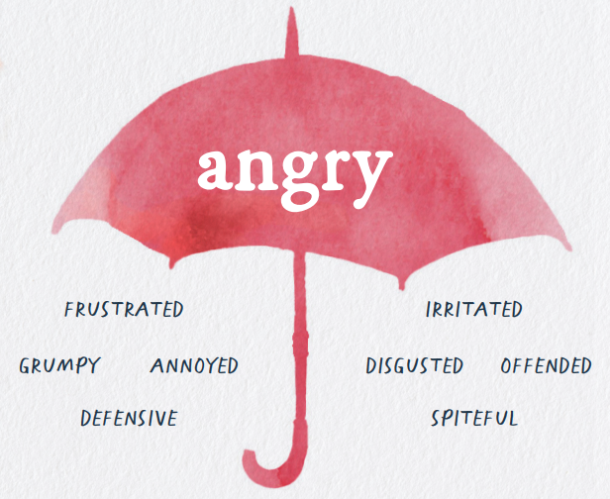
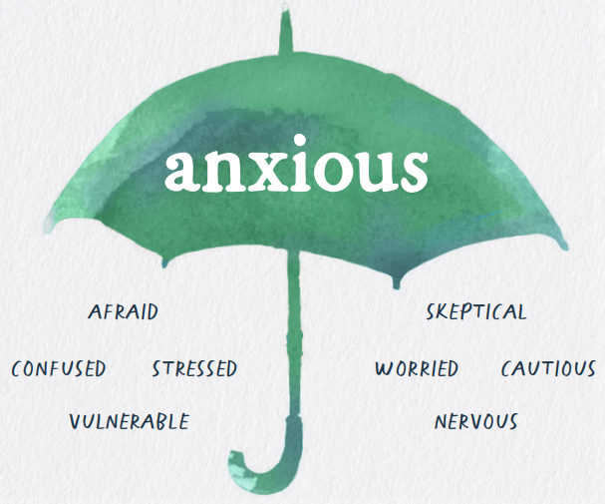
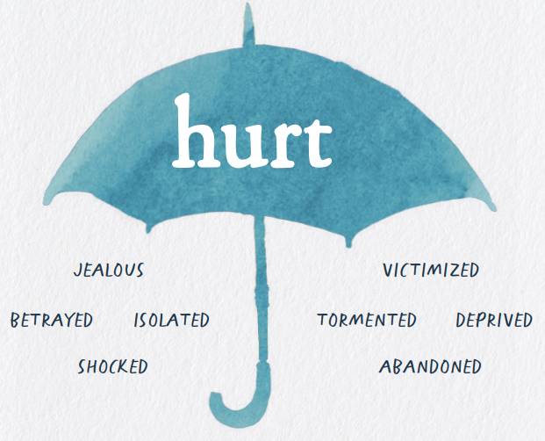
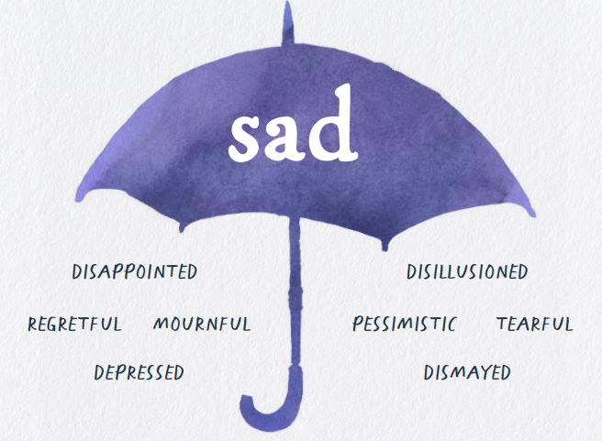
Free to download at: https://susan-david.ck.page/umbrellas
Notes:
What presents as one emotion, may be something else in disguise!
Also – neurodivergent parents may present differently to neurotypical parents
Heredity of trauma and some SEND

Slide 16
Co-production
Organisational level
Parent level
Pupil Level
Notes:
Not surface level and not just the SENCo – it threads through good practice – it is everyone’s business
School level – might be developing policies, considering changes to the school building/grounds, curriculum, structure etc – Consider ‘You said – We did’ feedback.
Parents- taking time to plan with parents from the start, individualised approaches
Pupil level – planning strategies or interventions to address a need, giving time to collecting meaningful pupil voice, use of conferencing

Slide 17
What our West Sussex parent carers tell us
“It is difficult to feel valued when you have to justify what you are saying”
“Don’t confuse my tricky home life with poor parenting”
“If they’d believed me, my child would have had the right support from the start “
Often reports use phrases like “Mum says ….” whereas most parent carers prefer to be referred to by their own name not “mum” or “dad”
Supportive relationships mean parent carers feel valued as experts on their own child
Notes:
From Autism in Schools project June 22

Slide 18
Then what?
What would they like to happen next?
What can we change?
How will we change it?
How will we check if the change is having a positive impact?
Consider how to manage expectations and agree realistic actions

Slide 19
Making Participation in Meetings Easier for Parents/Carers
Timings (time of day, length of meeting)
Clear information in accessible format
Information and discussion should be free of jargon/acronyms
Ensure that during the meeting you decide and plan together what you are going to do, how you are going to do it and what you’re going to achieve
Communicate what’s happened afterwards

Slide 20
Positive impact of working with parent carers
Research tells us if parent carers are actively involved in their children’s learning and activities at school then children are more likely to thrive academically and in their general wellbeing
This requires a systematic approach where families, teachers and support staff work together to support children to reach their full potential.
Anna Freud National Centre for Children and Families

Slide 21
Any further questions?

Slide 22
Recently published NASEN Spotlight book… discount code for 30% off TPSEND30 Available via www.nasen.org.uk

Slide 23
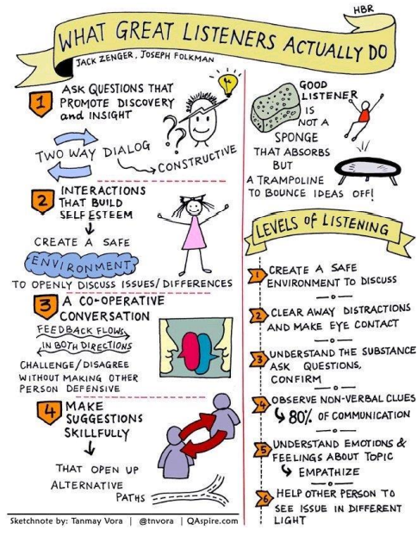
Notes:
To build confidence and relationships, be a good listener.
Use the levels of listening; Heather will talk about this more later on.
Safe and private environment
Away from distractions ‘do not disturb’ sign, redirect phone calls – this shows you value what they have to say
Confirm that you understand their views by summarising back to them what has been said
Empathise

Slide 24
With thanks to

