Slide 1



SENCO Conference - Autism in Schools Project workshop
Jane Crawford, Ellie Taylor-Burr, Hannah Torr| 21st June 2023 | Avisford Park Hotel

Slide 2
Autism in Schools Project - An NHS England funded initiative
To address the issue of mainstream schools failing to respond to the needs of autistic students, which evidence showed was leading to a high number of exclusions and was a key part of the journey to crisis and admission to inpatient settings.
West Sussex County Council, linked with the West Sussex Parent Carer Forum (WSPCF) as a key partner, to work in coproduction with the aim of transforming school environments and ethos and upskilling school staff thereby increasing capacity of schools to meet the needs of autistic students.

Slide 3

The criteria we built our project plan on
Build relationships and networks of support – including setting up mini parent carer forums in participating schools and linking education, health and social care professionals.
Create learning opportunities for schools and parent carer forums – including training and alternative CAMHS support in schools.
Develop Autism self-awareness and skills development in autistic children and young people and ensure their voices are heard - including small group work with autistic children and young people and their families.
Relationships – Learning – Developing children/young people
Notes:
Rowan

Slide 4
Creating learning opportunities and developing acceptance
All project schools working towards or have achieved Autism Aware Award.
Bespoke training informed by parent carer, pupil and staff surveys
Sensory environment audits carried out in all schools – range of actions in response and schools reporting impact for all pupils. Now beginning to repeat.
Secondary focus groups on specific curriculum subjects.
Including parent carers in training sessions whenever possible.
Piloting neurodiversity pupil awareness programmes – LEANS and Future Minds

Slide 5

Sensory environmental audit – key themes
Clear space around interactive whiteboard
Visuals contained within display boards, low arousal backing and content considered
Low arousal space for regulating in classroom and out of classroom
Consider impact of hanging displays e.g. washing lines

Slide 6
Sensory environment audit – listen to the pupils
FEEDBACK FROM ONE AUTISM AMBASSADOR GROUP: Pupil A finds it easier to focus on what is on display boards when they are contained within the boards. Otherwise he doesn’t know if he is meant to be using the information. Pupil B commented that with “too many colours, it is making my eyes blurry” and regarding washing line displays “too much from above”. Pupil C described how he often feels claustrophobic in classes – washing lines, lots of colour and tables in groupings can be a bit overwhelming. In one class the group noticed fewer displays and felt better. One commented “Mr XXX has smashed it with displays”

Slide 7
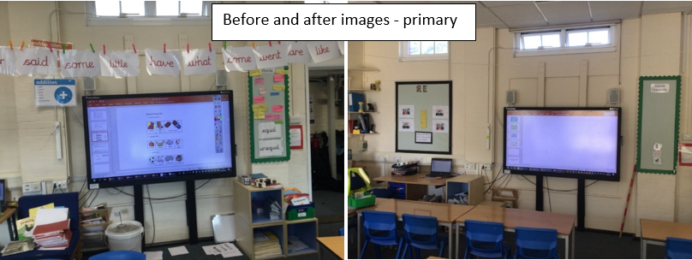

Slide 8
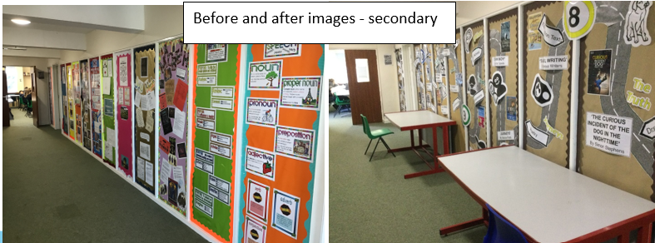

Slide 9
Embracing neurodiversity in school policies
AAA programme and AET standards requires review of school policies – Behaviour Policy, Accessibility Plan, SEND policy and SEND information report.
Some of the key themes from reviews:
  Move to focus on learning self-regulation and descriptions of behaviours to reactions and dysregulated behaviours
  Acknowledgement of the sensory demands of school and adaptations can be made
  Alternative provision for sensory and socially demanding free time
  Descriptions of difference rather than difficulty

Slide 10
Impact
Responding to autistic pupil voice from surveys – schools recording actions in response and impact.
“Masking” highlighted by Youth Forum to be shared with all staff now commonly discussing.
Observable change in use of language from deficit based to strength based
Staff confidence to adapt practice measurably improved.
Sensory environment adaptations having positive impact on all pupils – Year 2 example.

Slide 11


Impact - Feedback from our schools
Many training evaluations showed a shift from deficit to strength based view of autism amongst school staff, particularly after the pupil and parent carer voice module:
- “Reflecting on autism strengths”
- “No high/low functioning labels should EVER be used.”
- “Children and young people voice was very powerful- they are the experts.“
Staff delivering neurodiversity peer awareness programmes report impact on whole class/year group
Notes:
LEANS - “Both of us in Year 5, having a large proportion of children with neurodiverse needs in our classes, have noticed a significant improvement in the understanding from other children about the needs in our year group and why some children appear to get 'certain things' which they may have perceived as being unfair previously. The children are able to talk about what neurodiversity means and can give examples of conditions where these children may struggle in a classroom setting. The best thing from my perspective is having two children who were brave enough to disclose their neurodiversity in the classroom with confidence to all the other children, provoking surprise amongst others as they are not children where it is obvious. They were able to speak clearly about things they found hard and what helps in their learning. It has also been worthwhile talking about how the same diagnosis can present differently in different children and between boys and girls- we have talked a lot about masking and children have approached us with questions about themselves afterwards.

Slide 12
Impact – Feedback from our schools
A junior school Head Teacher commented on the transformative impact of the project , “Being involved in this project has had a profound impact on the way children with autism are seen and understood. It has moved our SEND provision on significantly and we will continue to build on the learning that we have undertaken as part of this project.”
One Head Teacher commented “Staff vocabulary is evolving. They talk of children masking – can see beyond what is facing them….are recognising elements in children and adjusting things in advance e.g around choice of activities…ultimately staff can see we may have X number of diagnosed autistic children in school but we have others (some we know awaiting that diagnosis and others not yet ) where the changes we have made are helping without the need for anyone ‘asking’ or us responding to a situation presenting itself “

Slide 13
Building relationships and networks of support
Partnering with West Sussex Parent Carer Forum

Slide 14


West Sussex Parent Carer Forum
What can we learn about parent engagement from the Autism in Schools Project?
Ellie Taylor-Burr, Project Coordinator, WSPCF

Slide 15
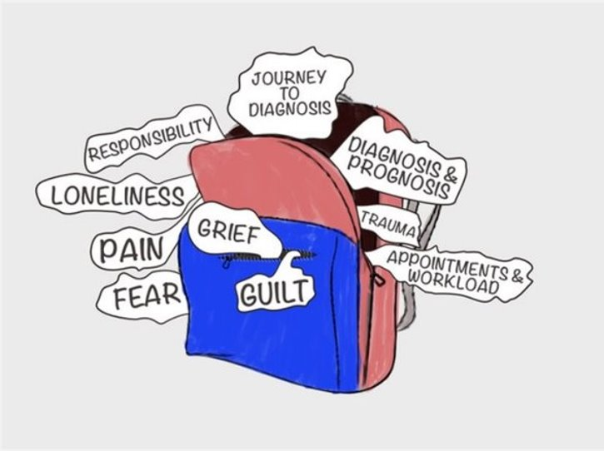
Why do SEND parents need 'extra' engagement?
Many schools have parent coffee mornings already, and PTA groups – why do SEND parents need their own one?
What is it like being a SEND parent at a mainstream school?
Isolation and need for peer support
Parents' own needs – for example, neurodivergence runs in families
Not sure how to approach school
In our starter survey, we asked: "How can working with parent carers be developed or strengthened in your child's school?"
64% of responses were based around one theme, and around half of those used the same word – any guesses?

Slide 16
What did we aim to do?
Our main focus was to set up a mini forum in each school, in order to:
Empower parents to deal with issues in a proactive way
Increase communication between school and parents
Decrease isolation by bringing parents together
Include all SEND families – more sustainable
Provide information, such as:
  Toby Silverman – neurodevelopmental pathway
  OT specialist - sensory issues
  Ordinarily Available Inclusive Practice
  Autism in girls, and masking, including lived experience

Slide 17
Adapting to different demographics
School A – formal, parent-run mini forum
Parents wanted formal group, including two confident parents keen to take the lead
Mini forum will liaise with SENCO, providing evidence of parent voice to SLT
School B – school facilitates mini forum
Parents felt a formal group was intimidating, and did not have capacity to run their own
SENCO involvement increased positive working relationships and provided quick solutions
School C – no mini forum
Barriers survey showed most parents can't commit to meetings e.g. due to work or childcare needs
SENCOs committed to holding 'open space' in the diary each month for drop-in chats

Slide 18
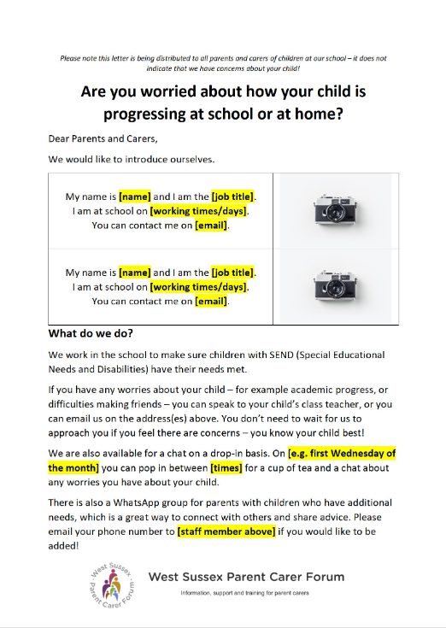
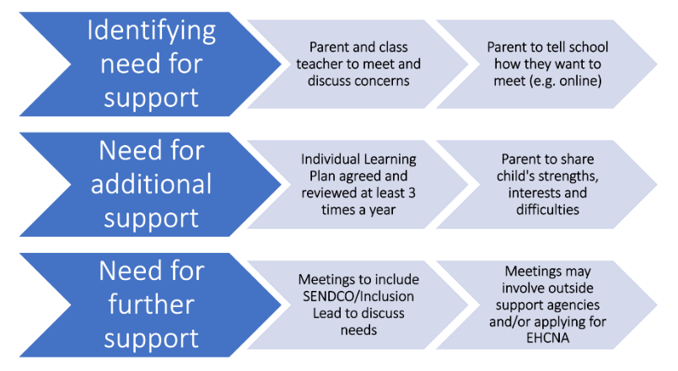
What other ways did we increase engagement?
New ways to reach parents e.g. school app/social media
Parent Involvement Policy – coproduced with parents
ILP input form
Southern Hub – joining schools together
Back to online sessions

Slide 19
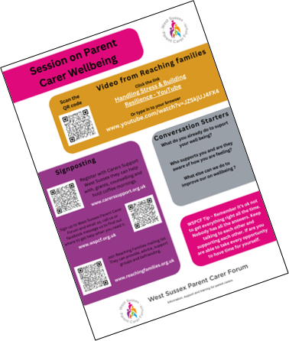
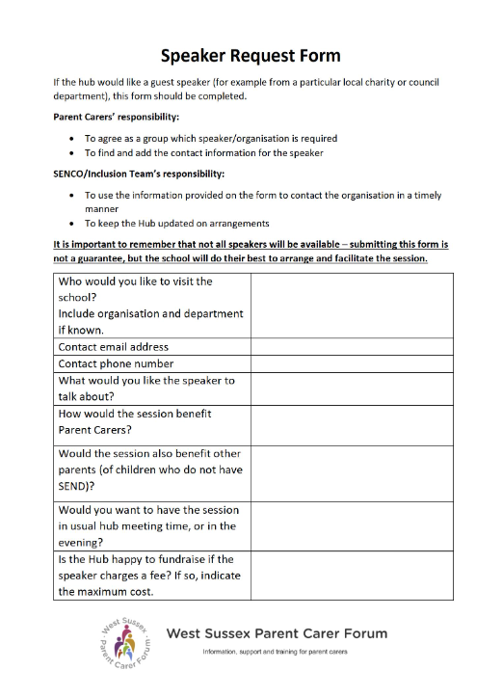

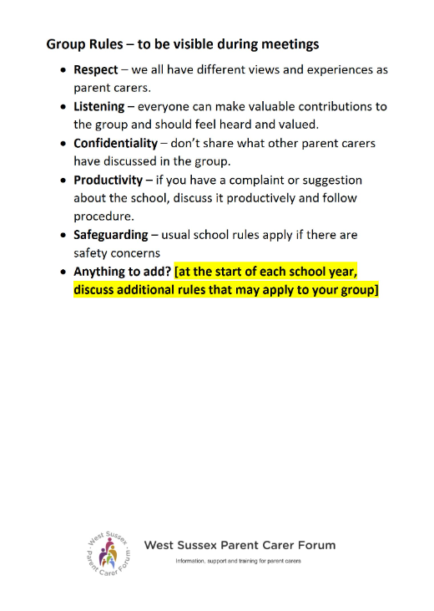
Supporting schools and parents with the Mini Forum Pack
Reflecting adaptive practice – welcome letter reminding schools and parents that they can pick and choose which resources to use, and that this can change if parents would like to make the group more formal
Informing parents – large signposting section, session planning resources
Empowering parents – sheets such as the minutes template, speaker request form and school feedback form help parents make a difference in the school and get their voices heard.

Slide 20
Key Messages
Proactive, not Reactive – increasing approachability pays dividends
Adaptability – meet parents where they are
Consistency – it is worth it – consider the difference you're making in the meantime

Slide 21
Developing self-awareness and ensuring autistic children and young people’s voices are heard
Pupil surveys becoming embedded in some schools practice and onus placed on class teachers/tutors to action and record impact
Worked with aspens to develop a 6-week autism programme which aspens delivered to groups in first cohort. Now supporting all schools to deliver.
Worked with City, University of London to measure impact on emotional wellbeing and engagement. Through online survey for pupils and their parent carers
Over 30% established autism ambassador groups
Short breaks funding for aspens half term transition emotional wellbeing

Slide 22


Developing self-awareness and ensuring autistic children and young people’s voices are heard
Notes:
Pupil surveys becoming embedded in some schools practice and onus placed on class teachers/tutors to action and record impact
Worked with aspens to develop a 6-week autism programme which aspens delivered to groups in first cohort. Now supporting all schools to deliver.
Worked with City, University of London to measure impact on emotional wellbeing and engagement. Through online survey for pupils and their parent carers
Over 30% established autism ambassador groups
Short breaks funding for aspens half term transition emotional wellbeing

Slide 23
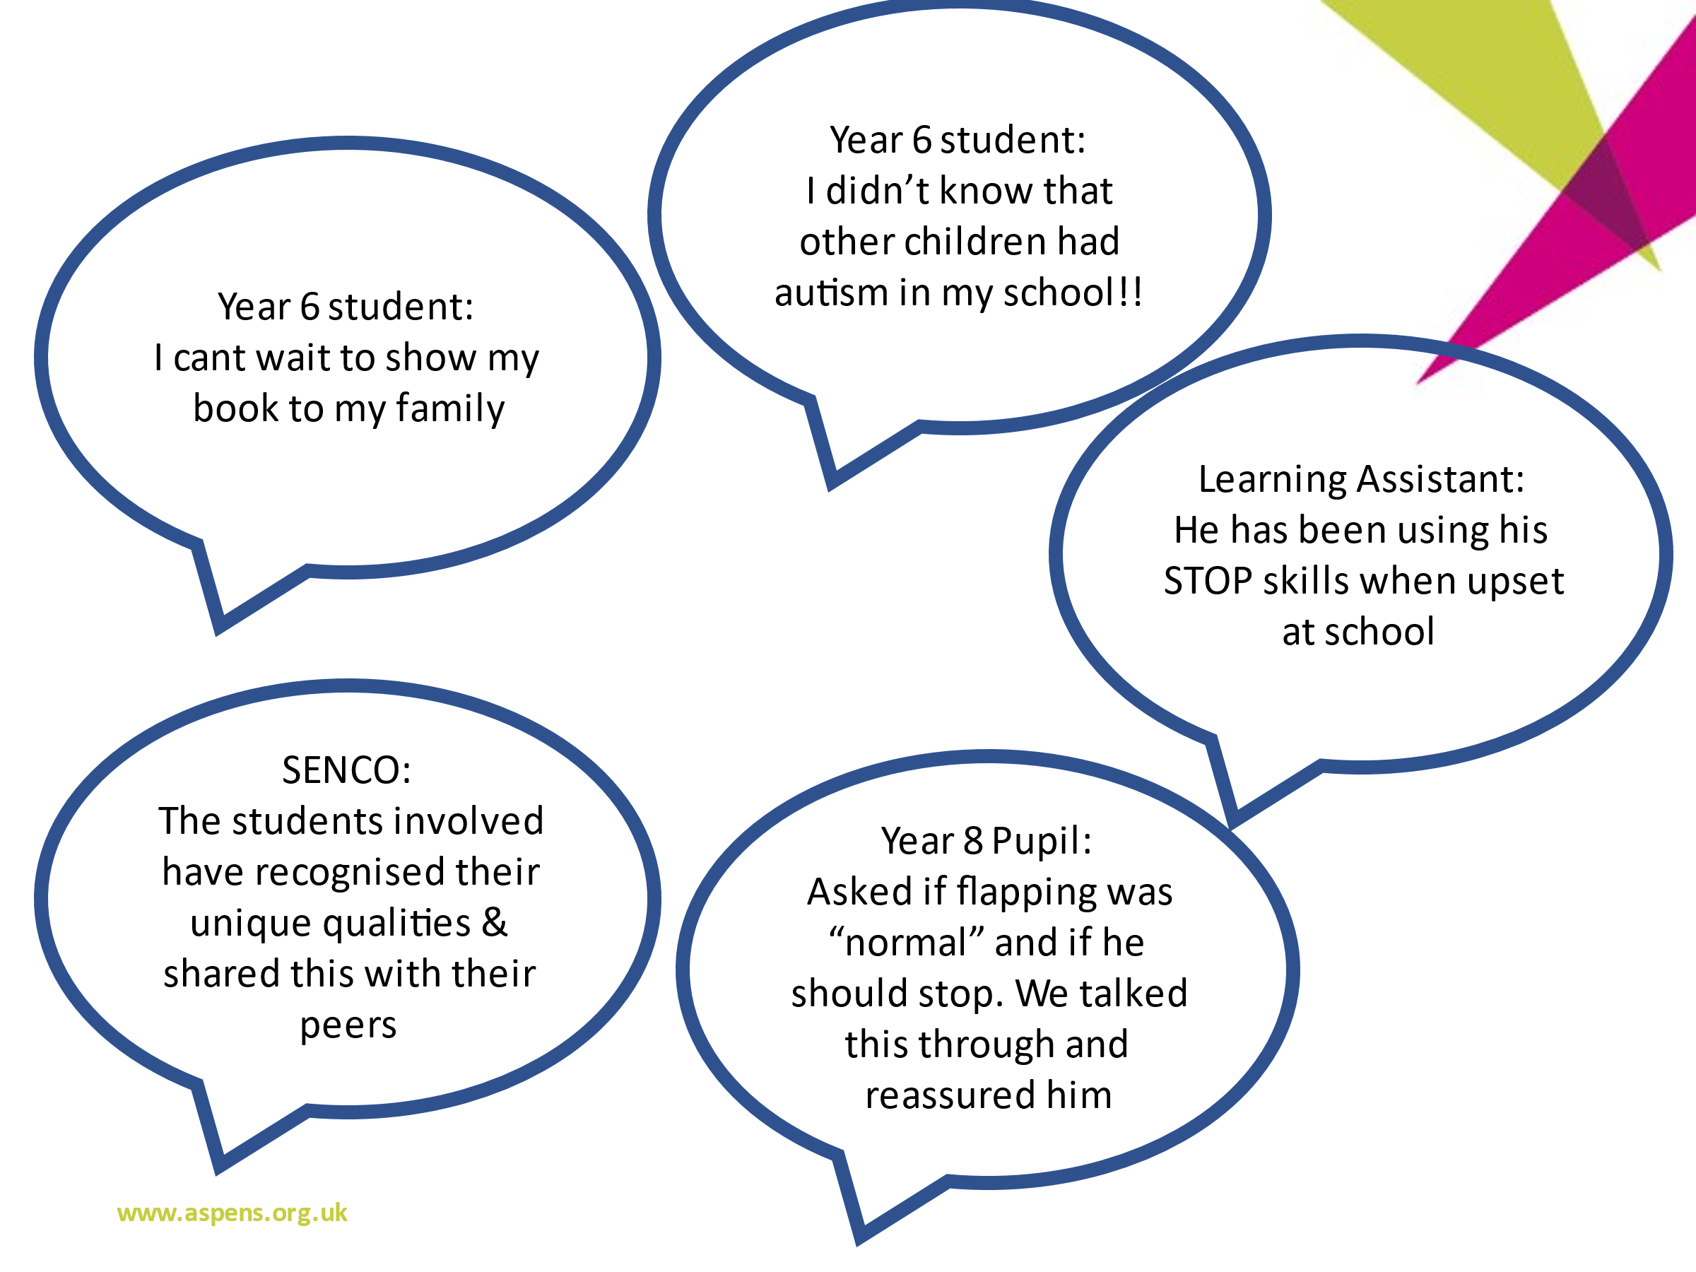

Slide 24

Accepting Autism – a total pupil production
All about me group video.MOV
Notes:
To see the full video visit the Windmills website

Slide 25
The Legacy
The value of ensuring “lived experience” is harnessed across all training. Young people and WSPCF have reviewed all training and parental involvement in training has been empowering
Supporting autistic children and young people to understand their difference and recognise their strengths is having a positive impact both on their self-esteem and ability to self-advocate. Autism ambassador groups in nearly half project schools.
Working with whole school using AET standards has supported change – policies, pupil and parent carer engagement, staff acceptance and confidence, whole school acceptance. However, no one size fits all.
Changes made positive impact on all pupils
Constantly learning from project - Initiatives continue to develop out of the project – autism and bilingualism, EBSA pupil programme, locality focus groups, LEANS and Future Minds neurodiversity peer programmes, increased number of autism ambassador groups

Slide 26

Any Questions?

