Slide 1
The Authentic Pupil Voice
Jessica Bubb and Kate Southgate

Slide 2
Aims
Why?
What are the benefits?
Exploring resources
Next steps?
Notes:
JC

Slide 3
UN Convention on the Rights of the Child
The 2015 SEN code of practice placed a stronger emphasis on engagement with children and young people in order to address any emerging difficulties, identify what is working well, what needs to be improved and to agree outcomes to work towards.
Giving children and young people a greater voice in planning and reviewing the support they receive can be empowering and increase impact and realise longer term aspirations.
The voice of the child is also a fundamental human right as reflected in the UN Convention on the Rights of the Child.
Every child has the right to express their views, feelings and wishes in all matters affecting them, and to have their views considered and taken seriously. This right applies at all times, for example during immigration proceedings, housing decisions or the child’s day-to-day home life.
Article 12 (respect for the views of the child)
Every child must be free to express their thoughts and opinions and to access all kinds of information, as long as it is within the law.
Article 13 (freedom of expression)

Slide 4
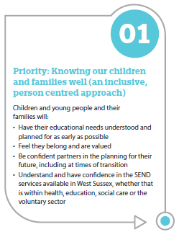
We aim to value Pupil and Parent Carer Voice in West Sussex
Notes:
JC

Slide 5
1.4. Communication
Is there evidence that…
A range of effective co-production and communication methods are used with children and young people (CYP), parent carers (parents) and the community to inform practice and foster positive relationships.
Notes:
JC

Slide 6
Partnership and co-production with children, young people and parents carers
Expectation 1
The school / setting works in co-production with children and young people and their parent carers in decision making.
Expectations from both school / settings and parent carers are realistic and support the child or young person’s learning, development and, in turn, outcomes.
Expectation 2
Children and young people are enabled to participate in their assessment and review processes.
Notes:
JC

Slide 7
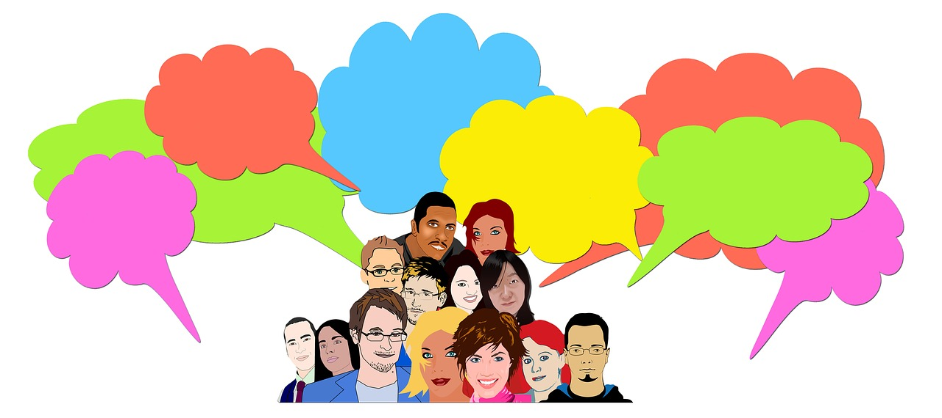
The Why and the benefits.
Why is it important to hear our pupils’ voices and what are the benefits?
Notes:
Flip chart

Slide 8
Benefits
Enhance emotional well-being, develop positive relationships and understanding of the CYP
Raise CYP’s self-esteem.
Develop sense of belonging
Develop a collaborative and inclusive environment.
Feel empowered and valued which increases motivation
To inform individual support and classroom practice
Inform school policy
Ensure the CYP individual needs are met
Enable CYP to share priorities
Create a sense of responsibility by enabling the CYP to give their views on actions for change.
Notes:
Raise self-esteem which is listened to and acted upon.
Increase knowledge and understanding of how a child or young person responds and views the support they receive.

Slide 9
What those with lived experience in West Sussex would like us to know
It is important for pupils to understand their communication style
Emphasis on “non speaking” rather than “non verbal”
Providing augmented and alternative communication opportunities for all?
“It is not about speech, it is about communication”
Notes:
Jane asked the youth forum
Autistic young people want to share their voice in a way that respects their rights and recognises their capacity to share their voice.
When teachers understand and accept the autism, fewer autistic young people felt the need to camouflage or mask who they were.
No one size fits all
Pupils were looking for a sense of belonging
‘Understanding the voices and educational experiences of autistic young people. From Research to Practice’ by Craig Goodall (2020)

Slide 10
Rewriting the Narrative by Dr Ruth Moyse (2021)
Shares the voice of pupils
“Just listen. It’s not rocket science” (Daisy) – their voices should form part of plans and assessments about them
“Be curious” (Robyn) – school staff need to query why they were absent from the classroom, playground or canteen.
“Prioritise pupil wellbeing” (Erin) – they need to be happy, feel safe and that they belonged in school – staff relationships and understanding key.
Notes:
JC

Slide 11
How do you gather pupil voice?
Methods of Gathering | Challenges Experienced

Slide 12
Things to consider
Strengths
Learning style/ additional needs
Identifying best person to gather pupil voice
Preferred communication style.
Audience- why? So what?
Time – how much time can we realistically spend with children to ensure that they are able to share with us freely.
Time of day
Does the CYP know why we want to hear their views
Ensuring that we are not tokenistic.
Value pupils response, it may not be our perspective but it is theirs.
Children may think that you are looking for a “correct” answer
Is there a power dynamic at play?
Being prepared for uncomfortable answers
Accepting “I don’t know”
Teach the child the process, time to practice
Notes:
Hearing- e.g. gaslighting disagree with the perspective and saying no no that isn’t true.
Sometimes there is a power dynamic – child needs to understand that you are listening and valuing – and repecting

Slide 13
Skills
Active listening
Sensitive
Be curious
Adapt process or resource
Be open
Be ready to hear
Notes:
Person- is it there
PACE-

Slide 14
How do you gather……
A reception child’s views
A non- verbal
Selective mute
EAL
Neurodivergent: Autistic child/ ADHD/ Dyslexia
Highly anxious child
Secondary pupil
Notes:
Issue of choice being difficult for some autistic pupils
Understanding of conceptual questions
Idea that contributing to decision making is a skill that needs to be learned, rather than assumed
Recognition of some pupils perception of power of some staff levels (ie SLT) to be able not only to listen but also to act on.

Slide 15
Structured Resources
Lego classroom
Listen to me
What helps me learn
Three houses
Mapping the Landscape of Fear
Bear cards
Blobs
West Sussex EBSA resources
Comic Strip Conversations
5 point scale check- ins
Zones of Regulation
All about me
EHCNA form pupil questions
Observation
Notes:
RB

Slide 16
How to
Lego Classroom

Slide 17
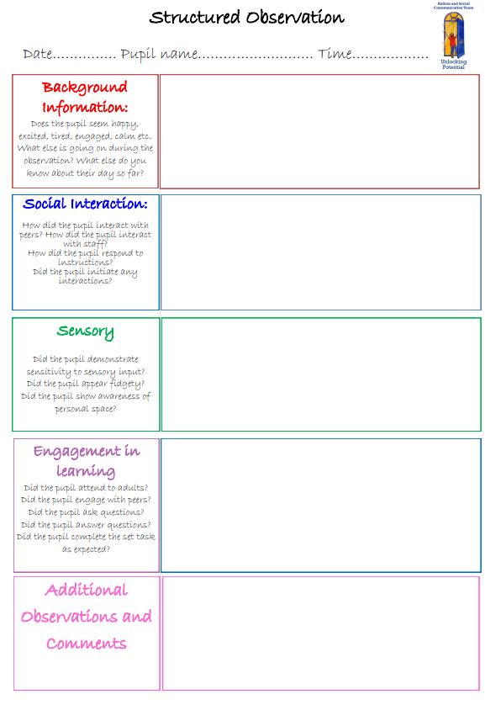
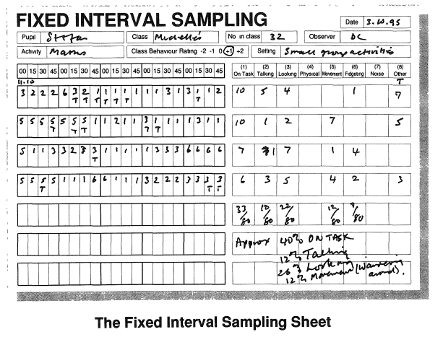
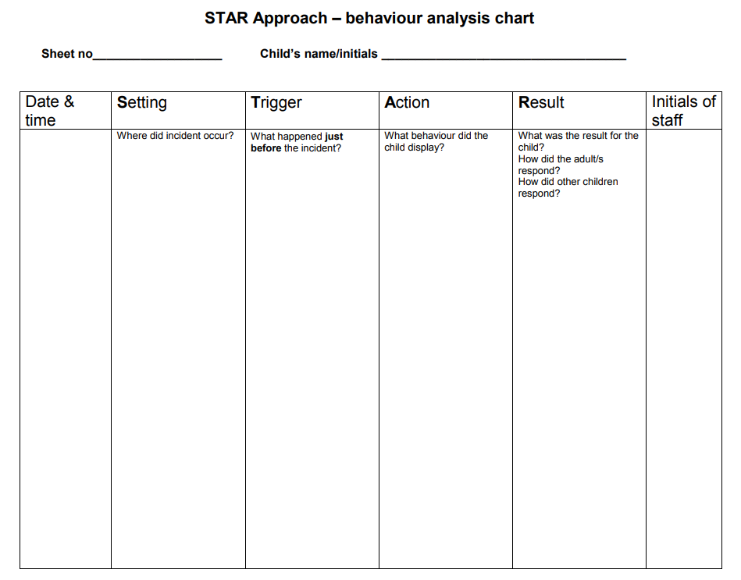
Observations

Slide 18
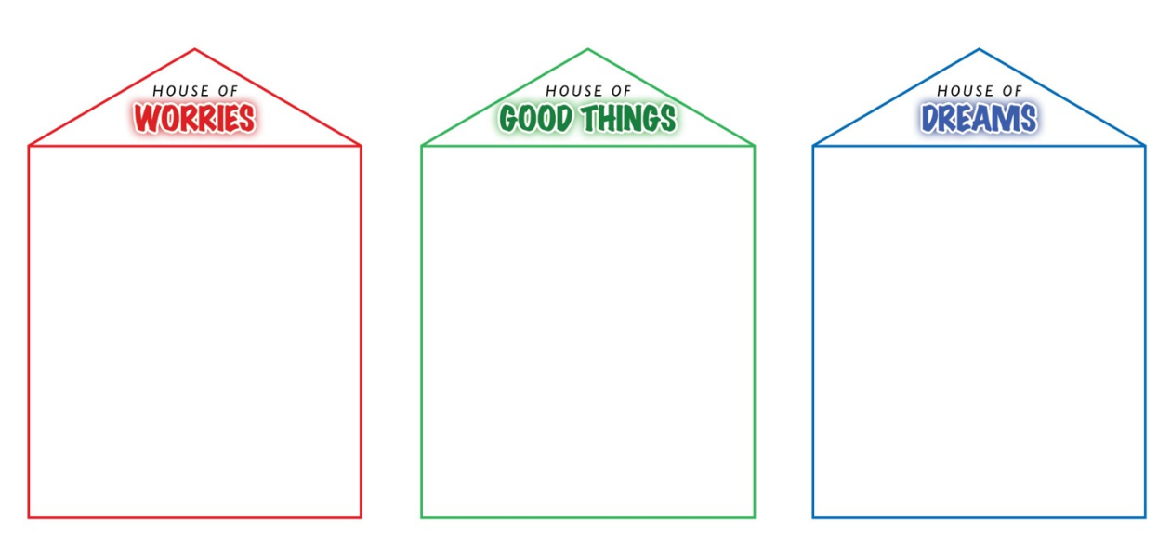

Slide 19
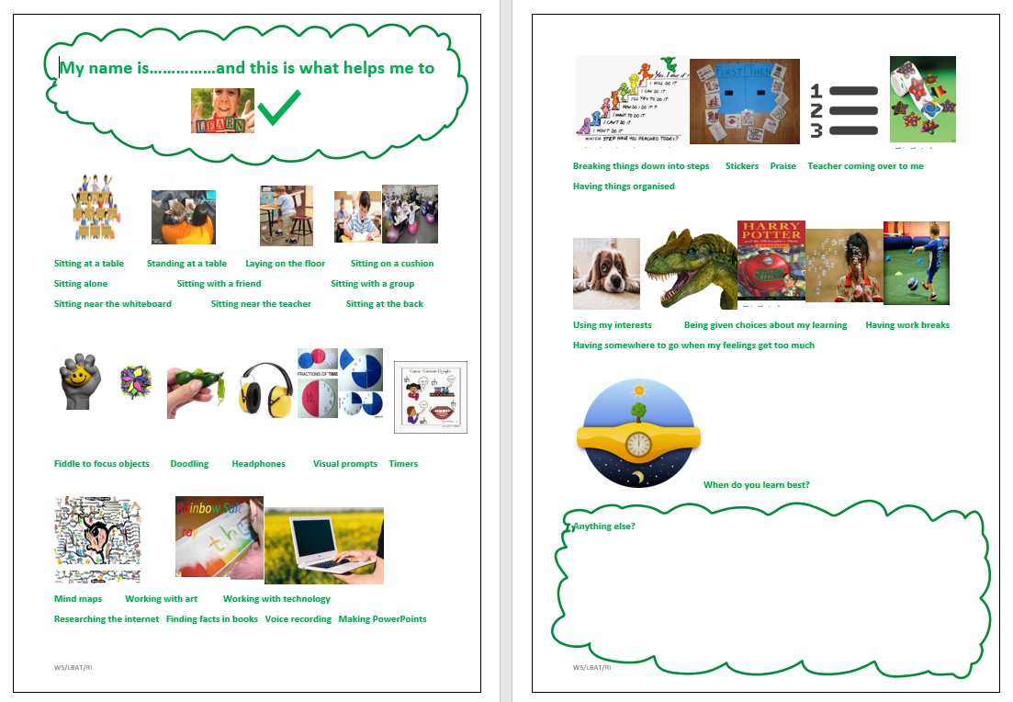

Slide 20
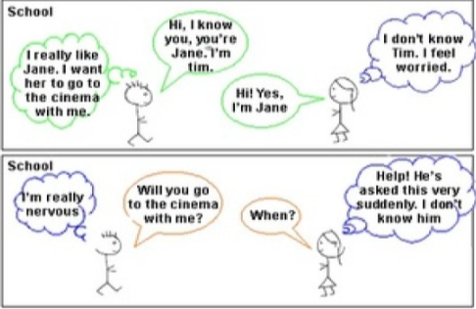
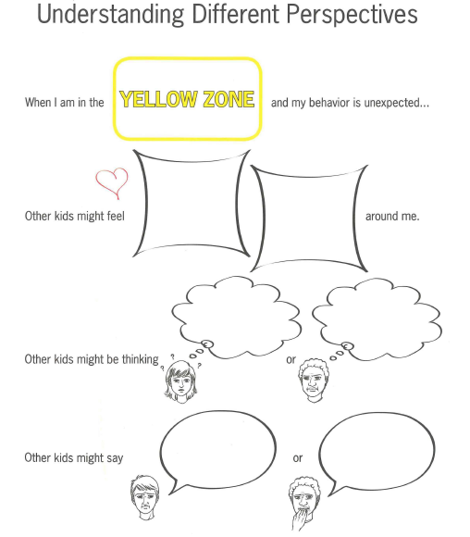
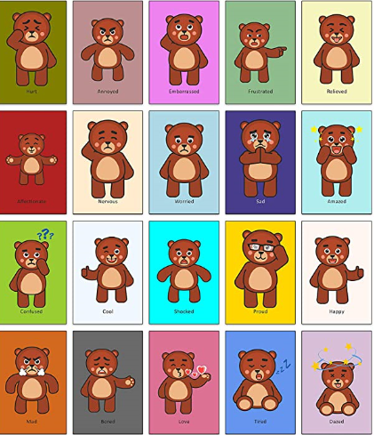
Supporting visuals
Notes:
JC

Slide 21
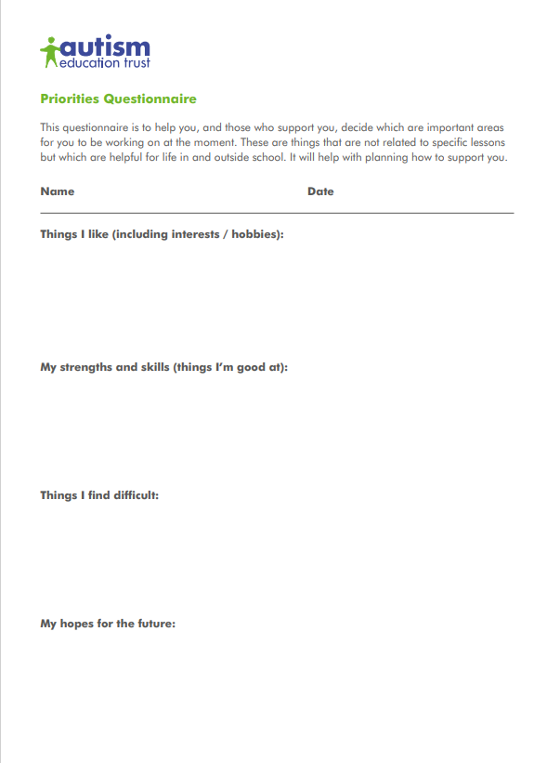
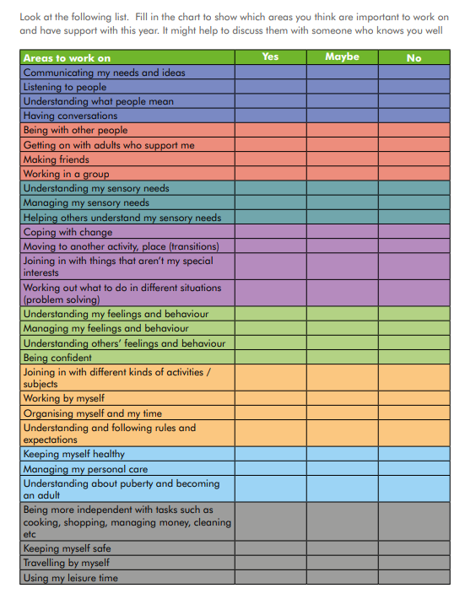

Slide 22
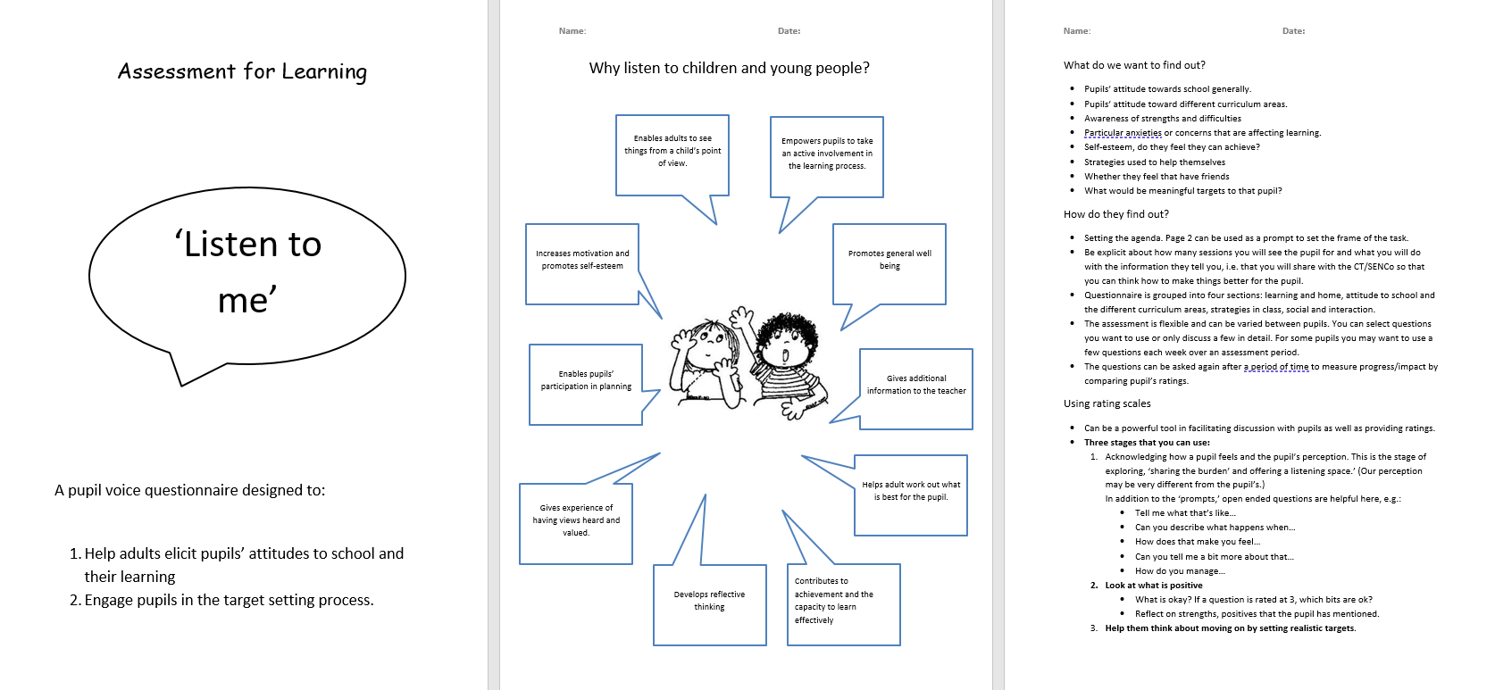
Notes:
Assessment for learning

Slide 23
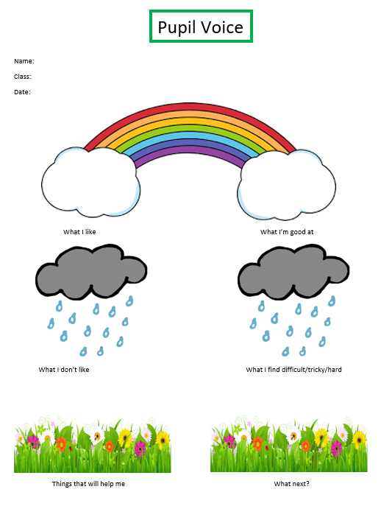
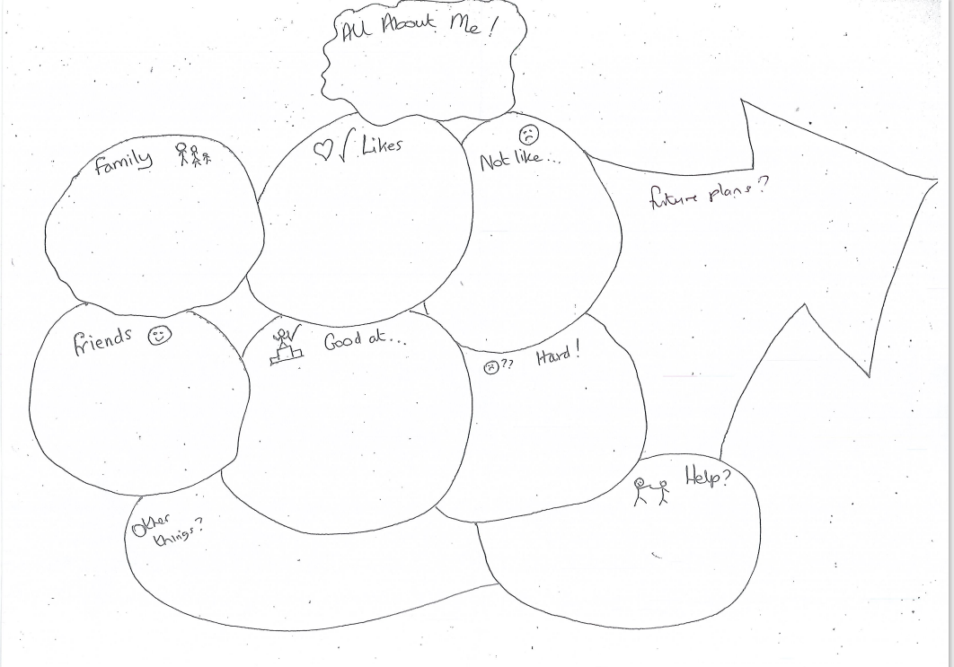
Notes:
The glebe and birchwood grove

Slide 24
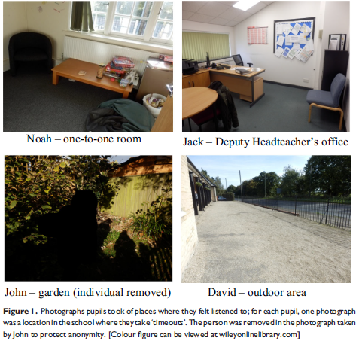
Photo elicitation
A practitioner research initiative across West Sussex, East Sussex and Brighton and Hove. The rationale:
Why are visuals sometimes better than words?
Permanent
Concrete starting point
Focal point (rather than direct interaction)
Play to strengths - detail focused
No set agenda to get wrong or right
Notes:
JC

Slide 25
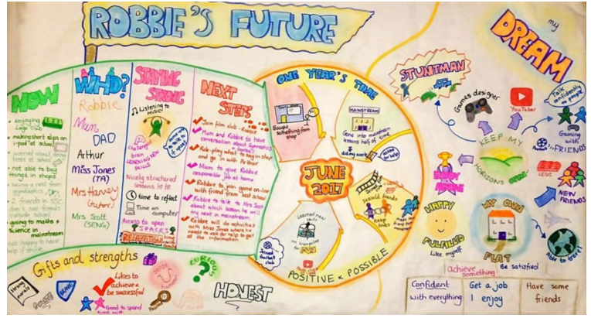
PATH
Person centred planning | Tools for schools (local-offer.org)

Slide 26
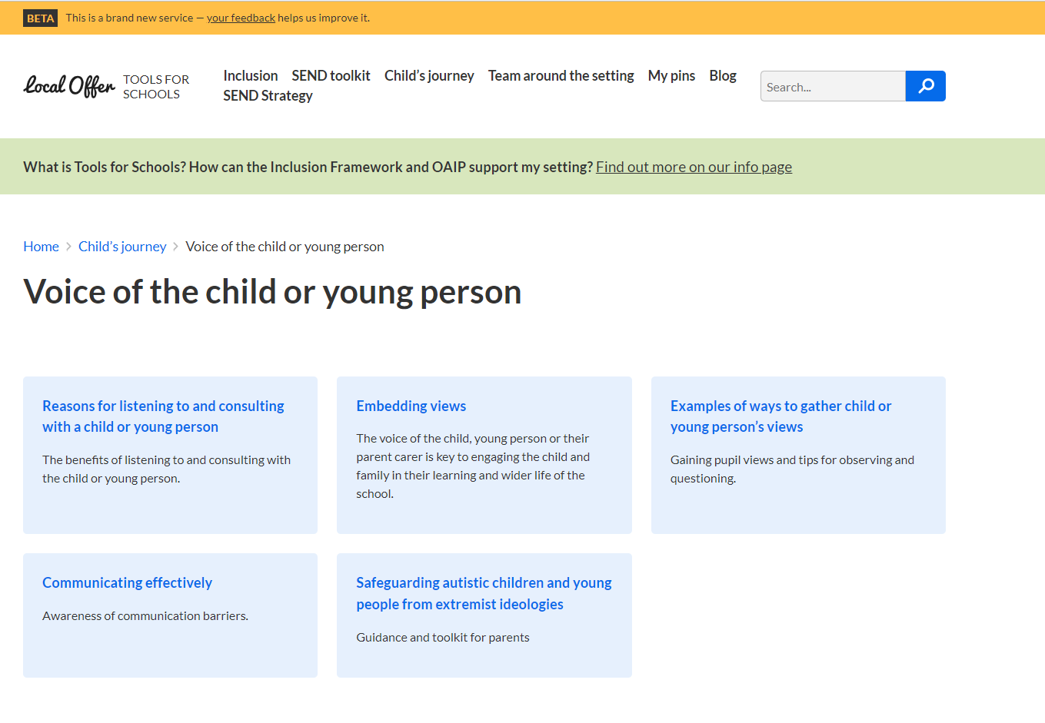
Links
Tools for Schools
Examples: Examples of ways to gather child or young person’s views | Tools for schools (local-offer.org)
Questioning to gain views: Questioning to gain views | Tools for schools (local-offer.org)
Role of the adult: Role of the adult | Tools for schools (local-offer.org)
EBSA: Emotionally Based School Avoidance | West Sussex Services for Schools

Slide 27
Pupil voice resources/strategies used
Informal methods also included:
Informal chats, check ins and incidental conversations
Wondering aloud
Walk and talk
Creative activities – e.g. LEGO classroom, art, photos, colouring
Notes:
RB

Slide 28
Then what- for the pupil?
What would they like to happen next?
What can we change?
How will we change it?
How will we check if the change is having a positive impact?
Consider how manage expectations and realistic actions
Notes:
RB

Slide 29
Any Questions and Evaluation
Notes:
RB Including to our lived experience representatives in the training.

