Slide 1
Developing an individual provision map

Slide 2
Developing high quality provision
Effective provision should:
Demonstrate that the Graduated approach has been applied
Include High Quality Teaching strategies
Describe Ordinarily Available Provision
Document targeted interventions

Slide 3
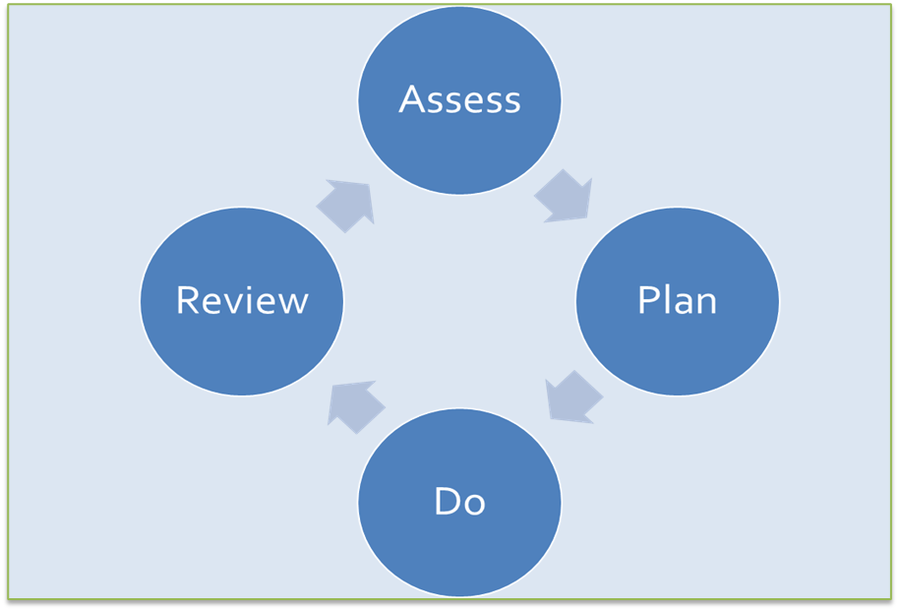
The Graduated Approach
Described in the SEND code of Practice (6.44 onwards)
Support should take the form of a four- part –cycle (APDR)
APDR : Assess, Plan, Do, Review
A growing understanding of the learner's needs and support required
Earlier decisions and actions are revisited, refined and revised
Draws on more detailed approaches, more frequent reviews
and more specialist expertise in successive cycles
Matches the adaptive approaches to the SEN of learner

Slide 4
High Quality Teaching
SEND code of Practice, 2015 "higher quality teaching ordinarily available to the whole class"
Provision should include High Quality Teaching strategies that address the barriers to learning and help the learner function more independently
These strategies fall into universal provision which every pupil is entitled to, they cannot therefore be included as a cost for the provision map, however it is helpful to detail them
Section 2 of the West Sussex Ordinarily Available Inclusive Practice (OAIP) is a useful document to refer to

Slide 5
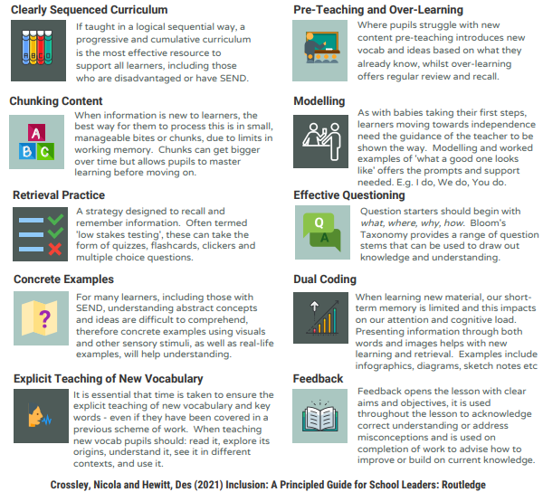
Quality First Teaching for Inclusion

Slide 6
Targeted provision focused on the specific needs of the pupil
Provision should focus on supporting the pupil’s needs, developing the pupil's independence and ensuring access to the full curriculum alongside their peers
Ensure there is a clear focus on what the pupil’s starting point is and what the intended outcome is, so that impact can be evaluated.
This provision is the ‘different from and additional to’ provision and should be costed within an individual provision map
Schools also need to ensure that staff are trained and competent to deliver support effectively

Slide 7
Managing the budget
The provision map should
cover the full academic year
show clearly how much of the school’s notional SEND budget is being used to support the pupil
link with the graduated approach
Where small group provision is used, costs should be calculated to show the proportion of time per pupil e.g. If the cost of a provision is £11 an hour and there are 4 pupils in a group, then the individual pupil’s cost is £11 ÷ 4 = £2.75 per pupil per session. So, if the provision is delivered twice a week for 12 weeks then the cost per term for each pupil is £66.

Slide 8
Focused on the needs of the pupil
Support must be focused on the needs of the pupil, not by the availability of certain types of provision within a school
Staff should remain flexible and creative in providing support in a way that will have the most impact on the pupil
Work strategically and do not offer too many interventions within a week as this can limit the pupil’s access to the curriculum and make it harder to evaluate the impact of each type of support.

Slide 9
Key Information
A Provision Map should:
Outline the APDR (Assess Plan Do Review) cycle
Include input from the learner, parents and specialists
Detail strengths, difficulties and barriers to accessing the curriculum
Identify the pupil’s starting point before the support is provided
Focus on the intended impact of the support provided and ensure that targets are Specific Measurable Achievable Realistic Time-bound (SMART)
Provide a clear overview of the assessed needs and how they impact on access to the curriculum
Specify Diagnoses (if relevant)
Describe the adaptive approaches that support the pupil in accessing the curriculum, making good progress and securing good outcomes
Include costs per pupil

Slide 10
Support for individual provision mapping is available from the
Learning & Behaviour Advisory Team (LBAT) and the
Autism & Social Communication Team (ASCT)

Slide 11
Useful Resources
West Sussex Ordinarily Available Inclusive Practice
Ordinarily Available Inclusive Practice (OAIP) | Tools for schools (local-offer.org)
West Sussex Provision Mapping Tools and Templates
Education, Health and Care Needs Assessment | Tools for schools (local-offer.org)
National Association for Special Educational Needs (NASEN)
provision_mapping_press_0.pdf (nasen.org.uk)
https://nasen.org.uk/resources/costed-provision-map-template-inclusive-practice
Education Endowment Foundation (EEF)
EEF_Special_Educational_Needs_in_Mainstream_Schools_Guidance_Report.pdf (educationendowmentfoundation.org.uk)

