Slide 1
St Wilfrid’s Wellbeing Garden
AP Provision
aka
“St Wilfrid’s Garden of Anxiety”
“The best thing I’ve done at the school”- the Head

Slide 2
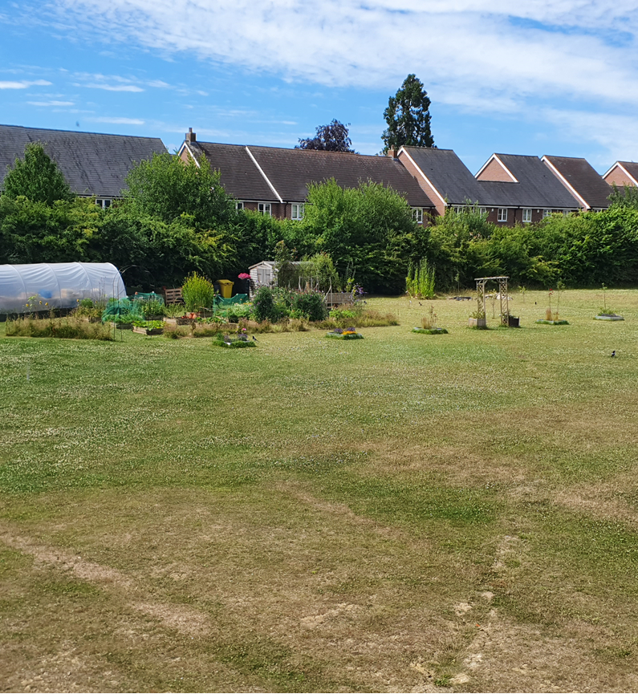
The Well-Being garden

Slide 3
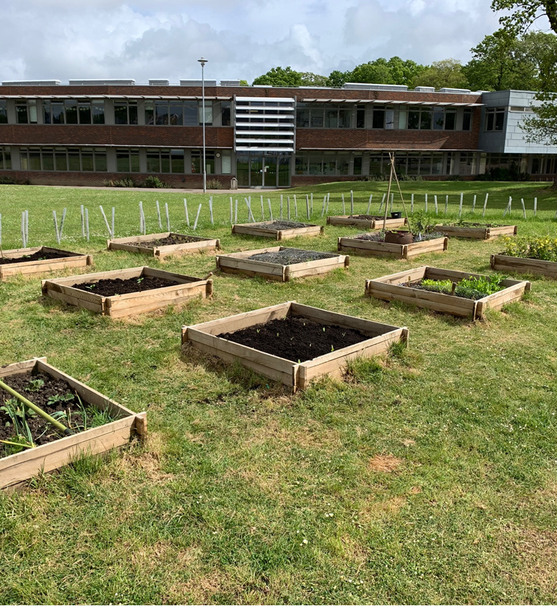
In the beginning…

Slide 4
….and now.

Slide 5
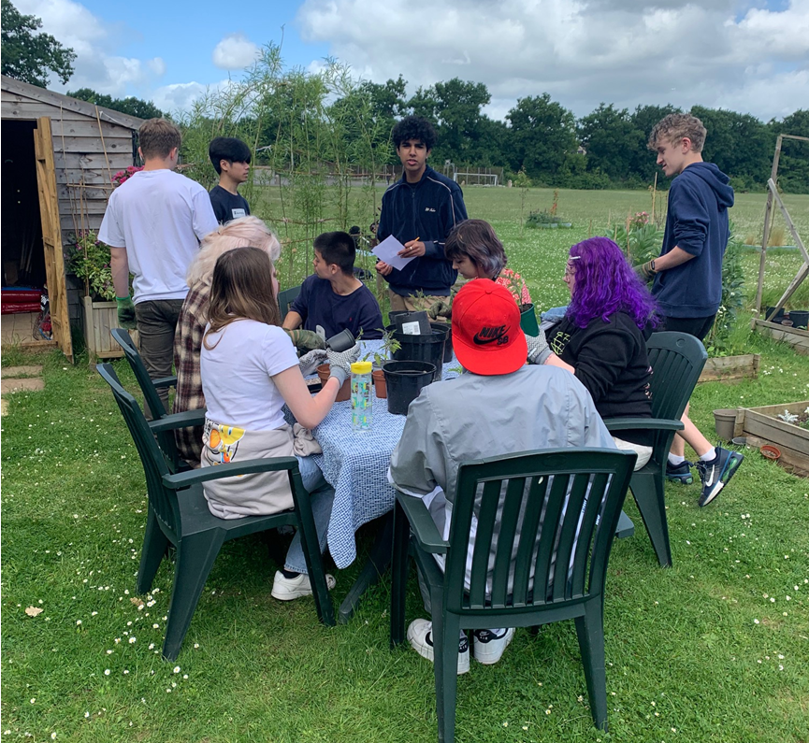
VI Form Spiritual Development/ General RE

Slide 6
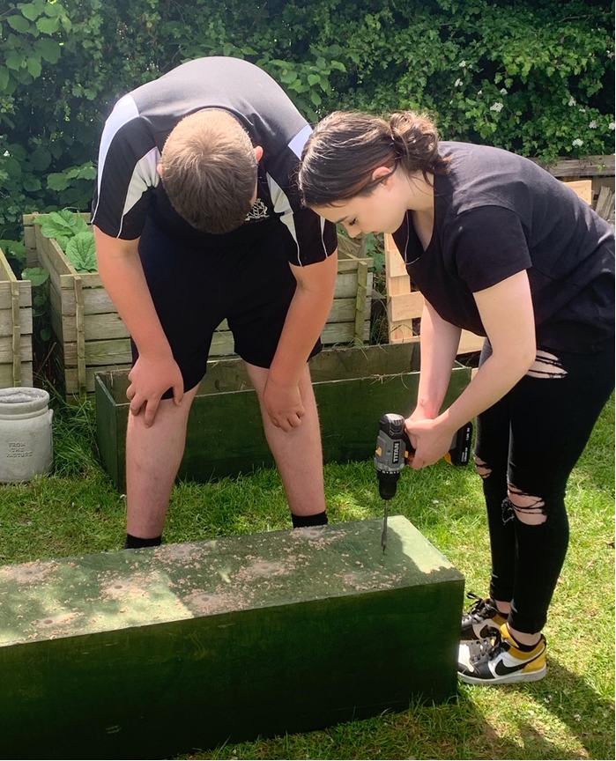

Slide 7
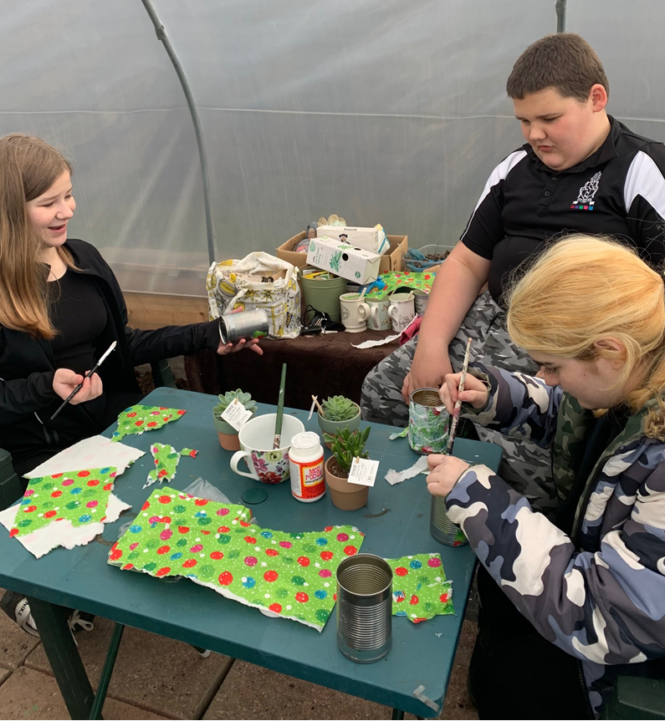
Crafts…

Slide 8
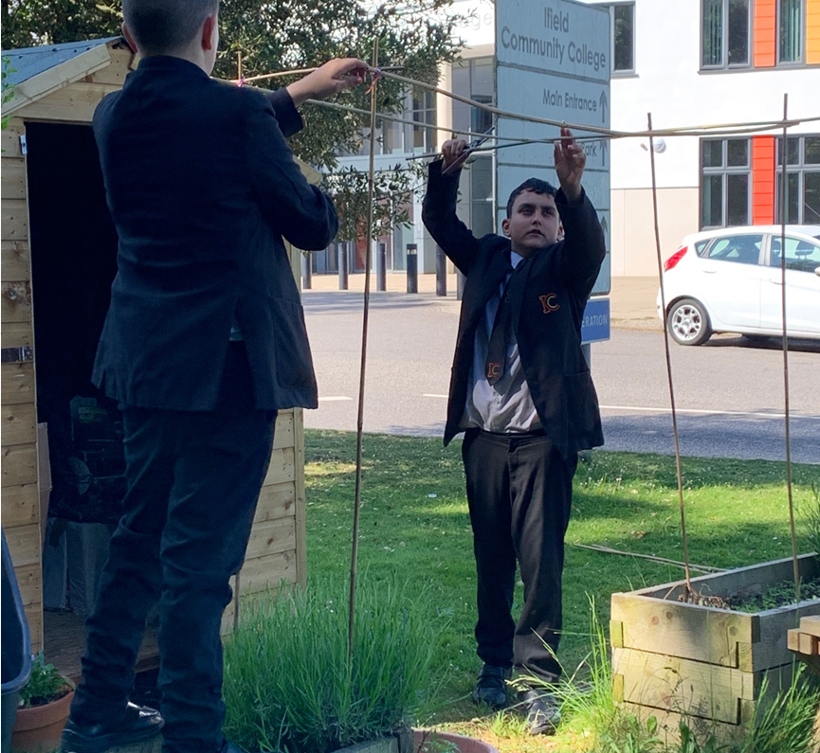
Shared AP with other local schools…

Slide 9
Building the garden..

Slide 10
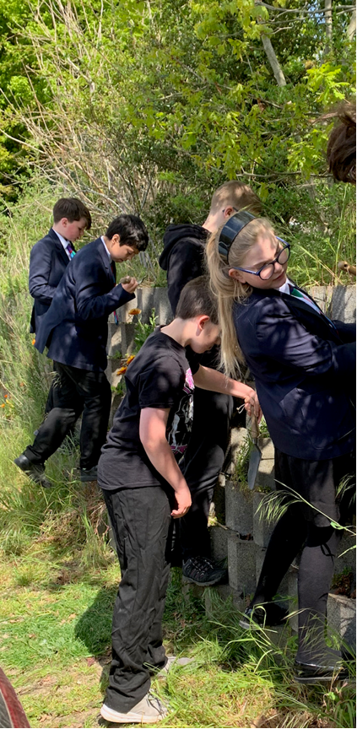
Guerrilla gardening…

Slide 11
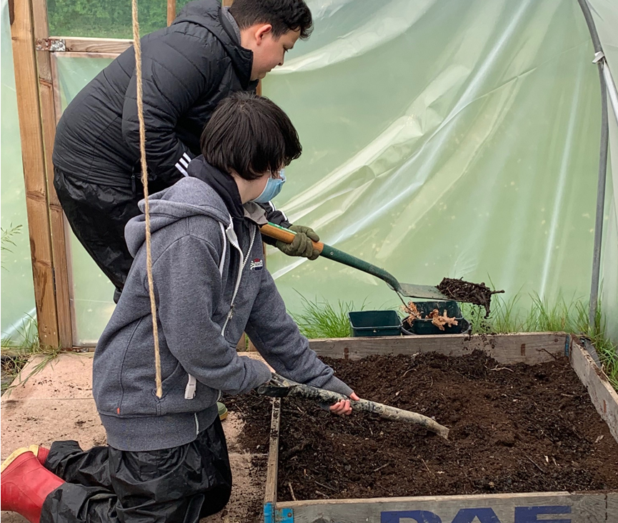
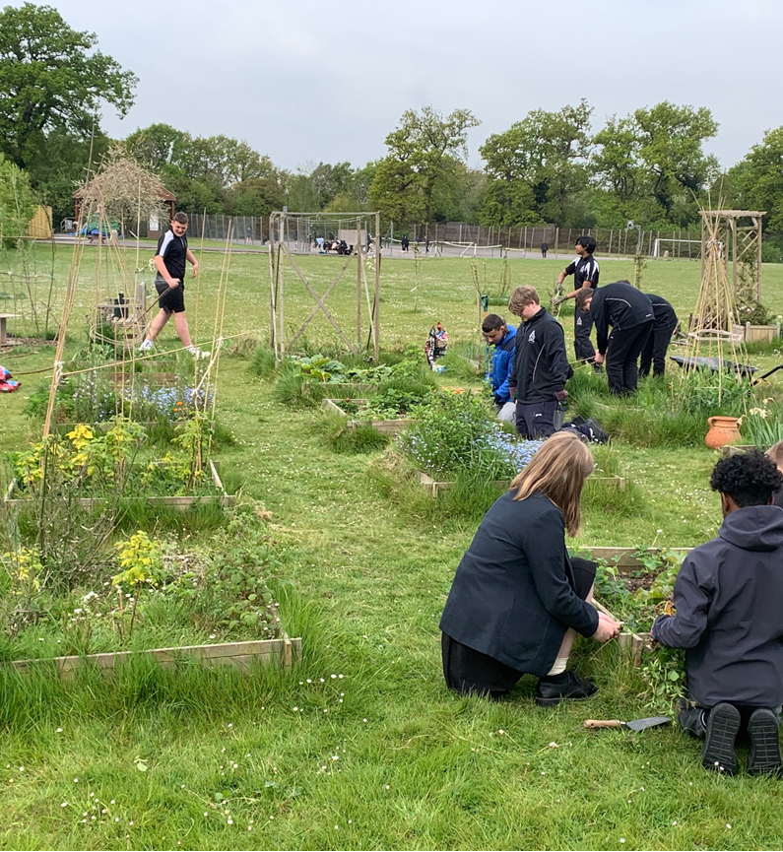
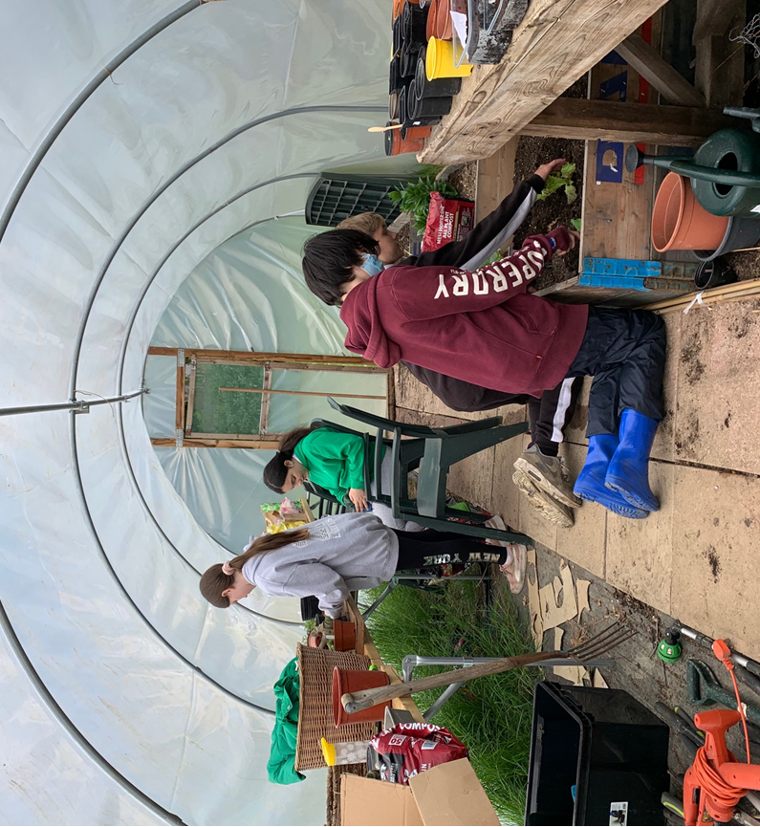
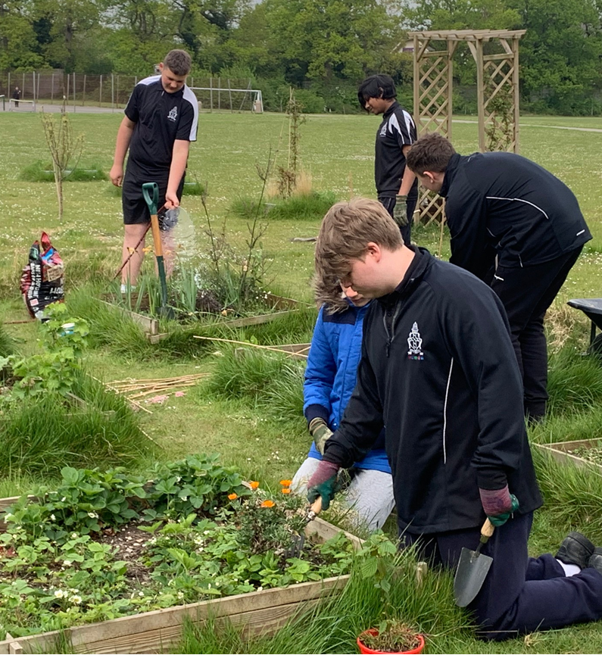

Slide 12
Any questions…?
What is the offer?
Who is it for?
How many pupils benefit
Progress tracking
Qualifications if appropriate
Staffing
Strengths and areas for development.

