Slide 1
Working Together: Making SEND Everyone’s Business
Amelie Thompson
rsl.seslon@wholeschoolsend.com
16th June 2022

Slide 2
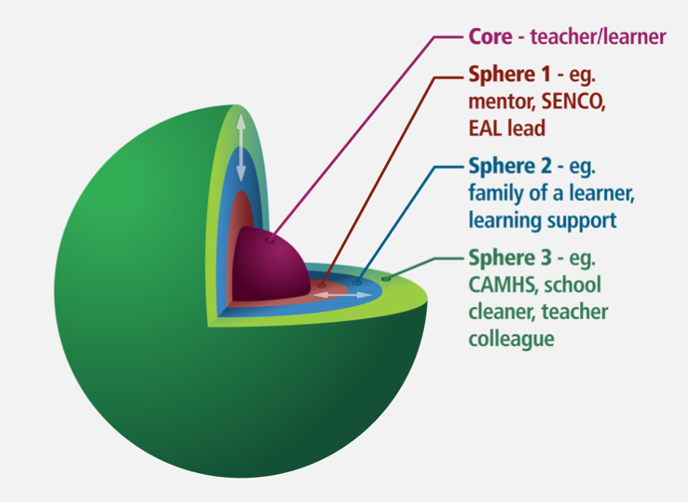
Today’s session
Reflect on our networks and our collaborative teams
How do we make SEND everyone’s business: practical considerations and strategies
Tools and resources
Notes:
Reflect back on sessions that we have already delivered – how we use data, how we use the graduated approach, what we mean by distributed leadership and tools that we can use to support this. Today will build on all of this but take it further towards the implementation.

Slide 3
Universal SEND Services contract
Notes:
PUT SEND GATEWAY UP AND SHOW WHERE TO ACCESS KEY INFORMATION AND RESOURCES
SHARE KEY ASPECTS OF THE CONTRACT – SEND modules, PD groups, networking etc.
Put up handbook and ITT resources for reference in the session.

Slide 4
What does inclusion mean?
Think of a book or a film that represents
inclusion to you and why?

Slide 5
What does inclusion mean?

Slide 6
Are we an inclusive school?

Slide 7
What are the driving forces and what are the restraining forces?

Slide 8
The SEND leadership model
Who’s in your team?

Slide 9
A professional role
…starting with you – the SENCO!
Take a moment to picture a SENCO – this might be you, a colleague or a ‘fictional SENCO’…
Thinking about them as a SENCO, how would you describe their role in the school? In the wider community?
Consider their role as experts? What would you describe them as being experts in?
Does this resonate with you? Is this how you would view yourself as a SENCO?
How would you describe your role? What do you see as your expertise?

Slide 10
A professional role
Hi!
Hi!
Our in-role expertise is not fixed, but develops as we learn and reflect.
Our ideas and practice are expanded and influenced by those around us and their expertise.
Our role is ‘performed’ in relation to other people.

Slide 11
Who is on our team?
Our role is never in isolation.
Our task at hand can be challenging at times. However, there is a wider community to support and encourage us as we learn and develop in the role.
Make a list.
In relation to how you carry out your role as a SENCO, who do you speak with…
Daily?
Weekly?
Fortnightly?
Termly?
Notes:
Middle and senior leaders, e.g. curriculum leads, phase leaders, SENCO, designated safeguarding lead, EAL lead, Pupil Premium lead
External agencies, e.g. specialist teachers, speech and language therapists, occupational therapists, educational psychologists, CAMHS
Wider professional networks, e.g. fellow trainee teachers, Whole School SEND, Maths Hub Programme, English Hubs programme, Chartered College, Teacher Union

Slide 12
The links? The interconnections?

Slide 13
How are we perceived by others, when we are in role and how do we perceive ourselves? How do we communicate our perceptions of others and how are these perceptions received?
How are we perceived by others, when we are in role and how do we perceive ourselves? How do we communicate our perceptions of others and how are these perceptions received?
For good team work to take place, it is important to recognise our preconceptions about each other and each other’s roles and to learn and respect the diverse contributions that each person plays in understanding a learner’s needs and therefore also in implementing effective provision to meet those needs.
We are people-in-role, and we are also people-in-role-in-relationship with others.

Slide 14
How can our practice be enriched by these relationships within the system?

Slide 15
Distributed Leadership

Slide 16
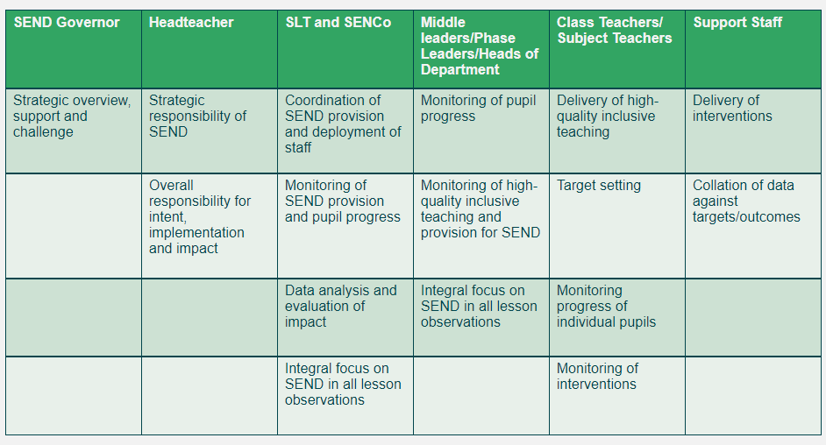
Distributed Leadership Example

Slide 17
Distributed leadership in action
Lesson Study process assessment not assumption
Middle leaders have subject specific guidance from Teacher Handbook
Every two weeks we have a pedagogy circle
Each department has a SEND Champion
Every Dept meeting we asks ‘what will that look like for struggling learners?’
Pastoral Tutors are leading EHCP reviews
Learning Walks by SLT supported by SENCO & T&L Lead
Notes:
Admin trained to pick up paperwork

Slide 18
EEF SEND Review Trial: Areas to Develop - Key Themes
The role of the SENDCO
Identification of SEND – SEND Systems
Use of the graduated approach
Deployment of Teaching Assistants
SEN Support - Interventions

Slide 19
Key Themes
The role of the SENDCO
Identification of SEND – SEND Systems
Use of the graduated approach
Deployment of Teaching Assistants
SEN Support - Interventions

Slide 20
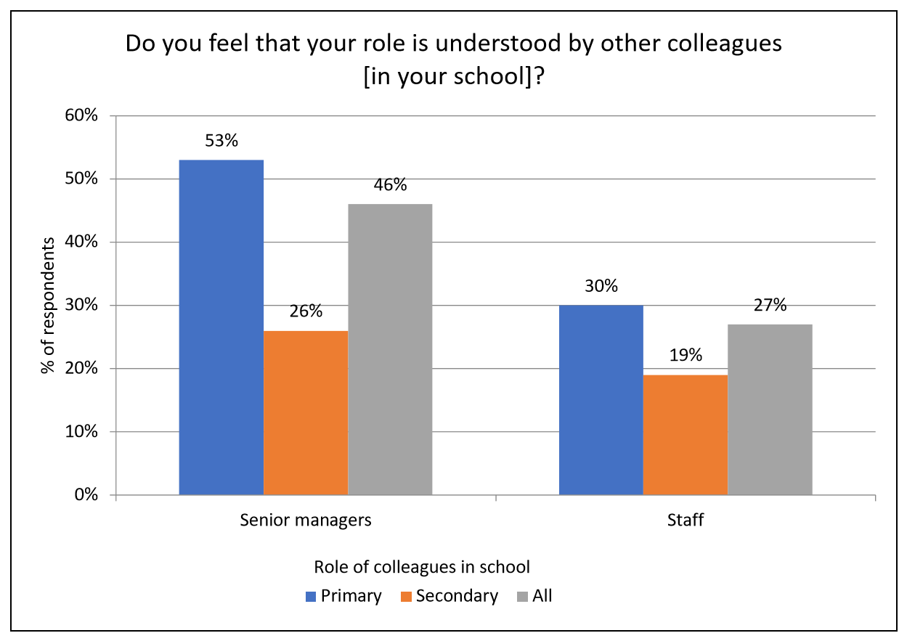
The role of the SENDCO
https://www.bathspa.ac.uk/media/bathspaacuk/education-/research/senco-workload/SENCOWorkloadReport-FINAL2018.pdf

Slide 21
The role of the SENDCO
SENDCO
Assistant SENDCO
(HLTA)
135 students on the SEND Register
135 autumn meetings
135 spring meetings
135 summer meetings
405 meetings a year – 15 minute meeting/15 minute prep – 202.5 hours – 25 days/academic year at 8 hours/day
30 form tutors
4.5 students with SEND per form
6.75 hours per form tutor/academic year
Enables SENDCO to go to more complex meetings (and more time to be in lessons observing students!)
Leadership commitment – how will this be built into directed time?
Notes:
SEND Code of Practice – statement re: termly planning meetings
case study
135 students with SEND – 405 meetings per year
6 form entry – 135/30…
Enables SENDCO
Leadership – how is this built into directed time?

Slide 22
The role of the SENDCO
Form 1
Form 2
Form 3
Is the SENCO best placed to know
the children in each classroom?
Form 4
Form 5
Form 6

Slide 23
Areas to Develop - Key Themes
The role of the SENDCO
Identification of SEND – SEND Systems
Use of the graduated approach
Deployment of Teaching Assistants
SEN Support - Interventions

Slide 24
SEND in England - Secondary
Nationally 13.5% students in secondary schools have SEND.
11.5% SEN Support – 2% EHCPs
Cognition and Learning (Green):
Specific Learning Difficulties
Moderate LD
Severe LD
Profound and Multiple LD
Social, Emotional and Mental Health Needs (Purple)
Communication and Interaction (Orange):
Speech, Language and Communication Needs
Autism Spectrum Disorder
Sensory and/or Physical (Grey):
Vision Impairment
Hearing Impairment
Multisensory Impairment
Physical Disability
Source: Special educational needs in England: January 2021 – GOV.UK

Slide 25
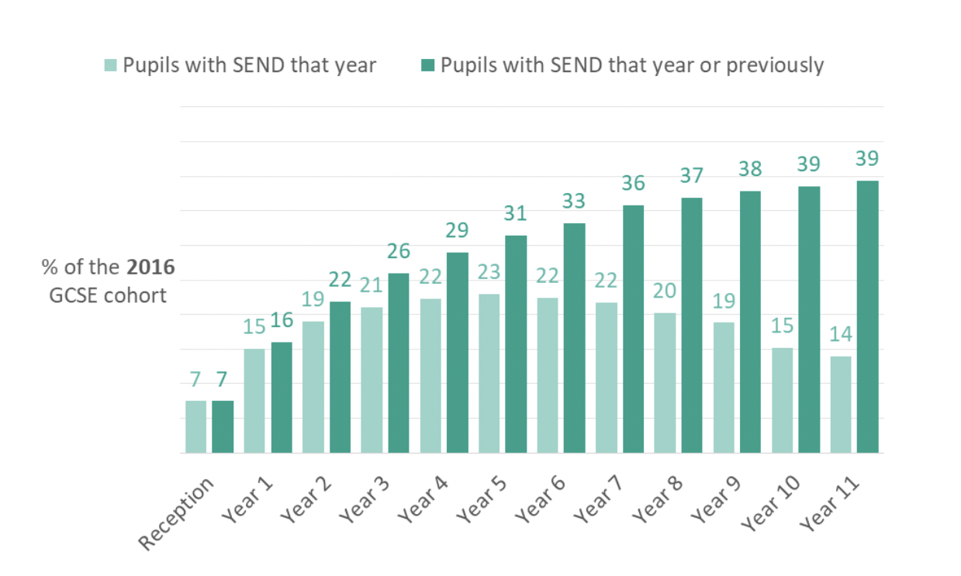
Identification of SEND – SEND Systems
Source: Education Policy Institute - How many children have SEND? Hutchinson (2017)

Slide 26
Identification of SEND – SEND Systems

Slide 27
Identification of SEND – SEND Systems
The most important finding from this report is that which primary school a child attends makes more difference to their chances of being identified with SEND than anything about them as an individual, their experiences or what local authority they live in.
Source: Education Policy Institute - How many children have SEND? Hutchinson (2017)

Slide 28
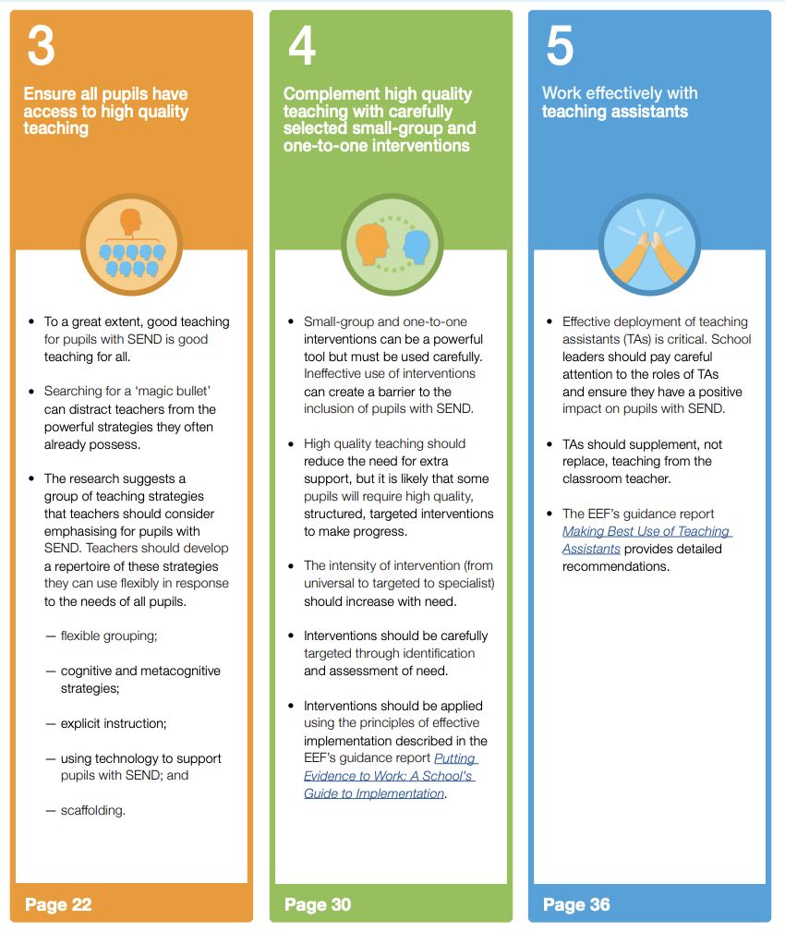
Identification of SEND – SEND Systems
Source: https://educationendowmentfoundation.org.uk/education-evidence/guidance-reports/send

Slide 29
Identification of SEND – SEND Systems
A pupil
struggling to access the curriculum
Teacher as detective
Let’s look closer.
What’s going on here?
Possible
underlying reasons
Working memory affects:
Recalling information
Recalling words
Holding onto information
Processing new information
Executive function affects:
Organisation
Planning
Focusing
Thinking flexibly

Slide 30
Areas to Develop - Key Themes
The role of the SENDCO
Identification of SEND – SEND Systems
Use of the graduated approach
Deployment of Teaching Assistants
SEN Support - Interventions

Slide 31
Use of the graduated approach

Slide 32
Use of the graduated approach

Slide 33
Use of the graduated approach
Subject-specific Guidance
Written by currently practicing SLEs and/or Heads of Department – reviewed by DfE and Ofsted
Planning inclusive lessons
Creating an inclusive environment
Curriculum considerations
Strategies to scaffold learning
How can I support learners who struggle to retain vocabulary?
How can I support learners who struggle to access lessons because of literacy difficulties?
How can I support learners who struggle to access lessons because of numeracy difficulties?
How can I support learners who need additional time to develop conceptual understanding?
How can I support learners who struggle with attention?
How can I support learners who struggle with change and transition?
Subject-specific questions, e.g. How can I support learners who lack confidence in their own mathematical ability?
5. Case Studies or worked examples of tasks
Notes:
Secondary: Maths, English, Drama, Science, Music, Art and Design, PE, Computing, MFL

Slide 34
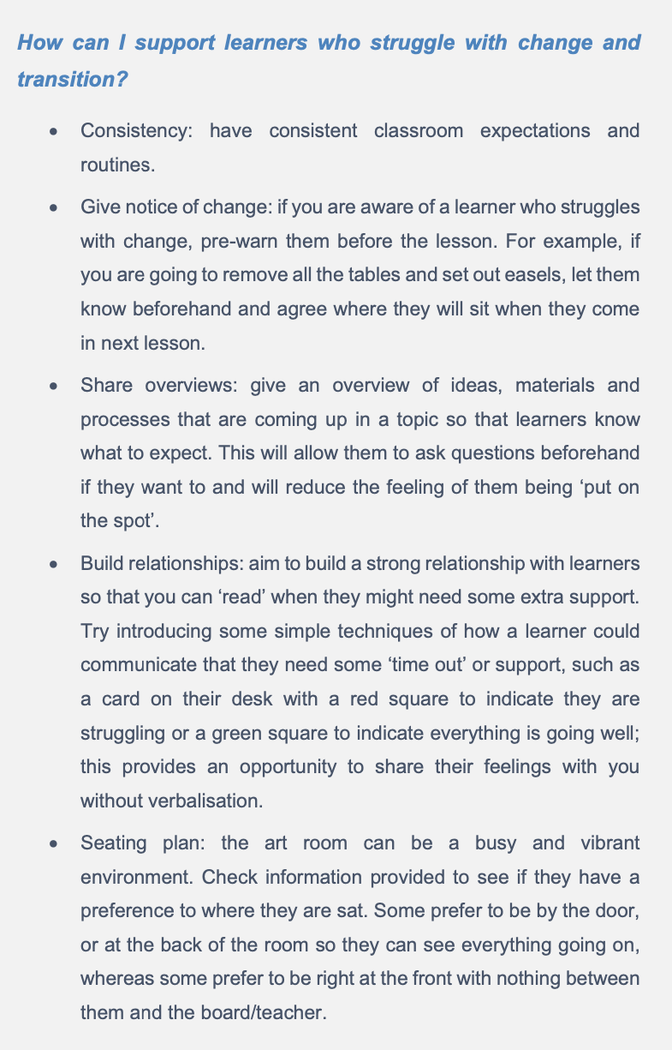
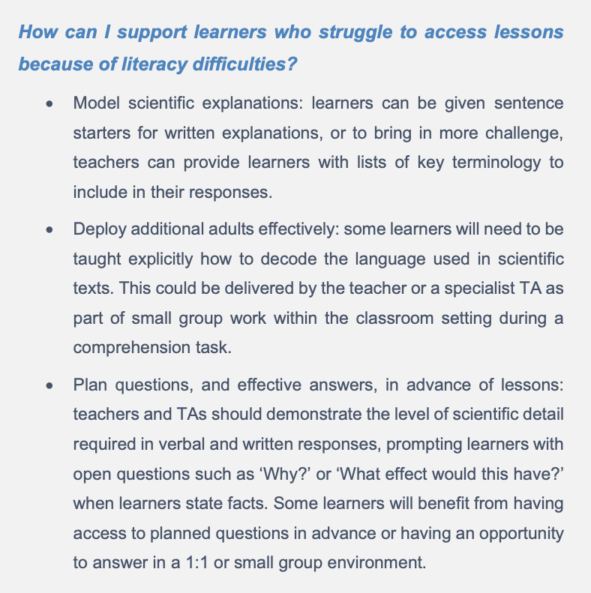
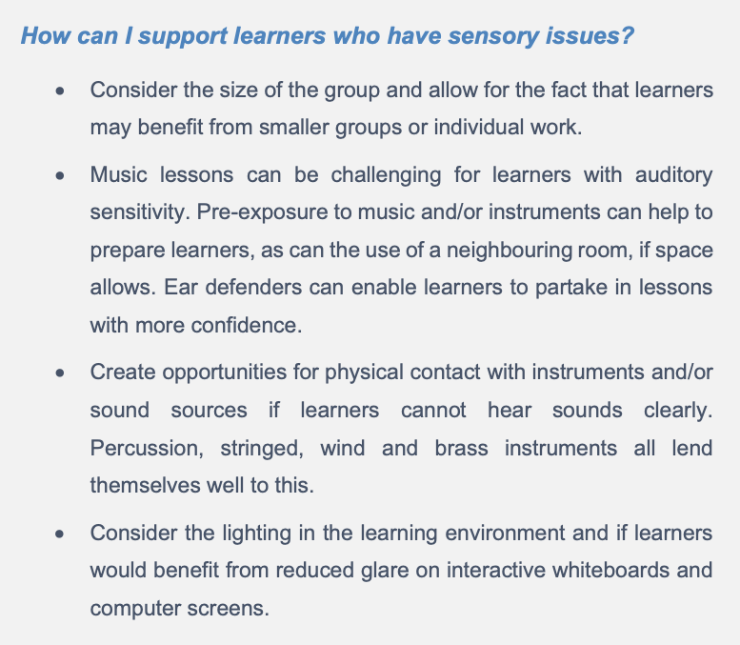
Use of the graduated approach
Science
Music
Art and design

Slide 35
Areas to Develop - Key Themes
The role of the SENDCO
Identification of SEND – SEND Systems
Use of the graduated approach
Deployment of Teaching Assistants
SEN Support - Interventions

Slide 36
Deployment of Teaching Assistants
Adapted from Friend, M. and Bursack, W.D. (2009)

Slide 37
Areas to Develop - Key Themes
The role of the SENDCO
Identification of SEND – SEND Systems
Use of the graduated approach in subject departments
Deployment of Teaching Assistants
SEN Support - Interventions

Slide 38
SEN Support - Interventions
How can we use the graduated approach
(assess–plan–do–review)
to identify when intervention is needed?

Slide 39
SEN Support - Interventions
It is tempting to talk about the challenge of SEND as a specific and distinct issue.
Yet, far from creating new programmes, the evidence tells us that teachers should instead prioritise familiar but powerful strategies, like scaffolding and explicit instruction, to support their pupils with SEND.
Source: https://educationendowmentfoundation.org.uk/education-evidence/guidance-reports/send

Slide 40
SEN Support - Interventions
Five recommendations:
Create a positive and supportive environment for all pupils without exception.
Build an ongoing, holistic understanding of your pupils and their needs.
Ensure all pupils have access to high quality teaching.
Complement high quality teaching with carefully selected small-group and one-to-one interventions.
Work effectively with teaching assistants.
Source: https://educationendowmentfoundation.org.uk/education-evidence/guidance-reports/send

Slide 41
SEN Support - Interventions
Who plans and delivers maths interventions?
SENDCO
Maths teachers
TAs
SENDCO
Maths HoD
Maths HoD
TAs
Maths teachers
30 form tutors
4.5 students with SEND per form
6.75 hours per form tutor/academic year

Slide 42
Key resources
Understanding your role
Knowledge of the learner
Planning inclusive lessons
Creating an inclusive environment
Subject-specific guidance
Graduated approach
Strategies to scaffold learning (condition-specific guidance)
Teacher wellbeing
https://www.wholeschoolsend.org.uk/

Slide 43
Culture
Professional learning and Teacher Education
Communities and Partnerships
Pedagogy and Innovation
Vulnerable
learners
School improvement

Slide 44
Culture
Professional learning and Teacher Education
Communities and Partnerships
Pedagogy and Innovation
Vulnerable
learners
School improvement

Slide 45
Any questions?
This Photo by Unknown Author is licensed under CC BY-NC

