Slide 1
Requesting an
Education, Health and Care Needs Assessment (EHCNA)
Special Needs Officers
Our contact details can be found here:
https://schools.local-offer.org/team-around-the-school/training-and-development/special-needs-officer-snos/

Slide 2
We will cover:
Section 1
Guidance to consider before making an EHCNA request
Ordinarily available inclusive practice
The graduated approach/SEN support
Section 2
Information needed to make a EHCNA request
Pupil Voice
Provision maps
Section 3
How to submit an EHCNA request
What happens next?

Slide 3
Section 1
Guidance to consider before making an EHCNA request
Ordinarily available inclusive practice
The graduated approach/SEN support
Notes:
Adapted layout

Slide 4
An EHCNA is an assessment of a child or young persons education, health and social care needs. What to think about?
In West Sussex a request for assessment must demonstrate implementation of appropriate approaches set out in the Ordinarily Available Inclusive Practice (OAIP) guidance as part of the graduated approach to meeting the pupil’s needs.
Settings need to demonstrate that despite this relevant and purposeful action, the pupil has not made expected progress.
What SEN support do you already have in place and is the child/young person making progress?
What will an education health and care plan do/provide for the child/young person that is not already provided?
Have you looked in detail at guidance and criteria for EHCNA requests? https://schools.local-offer.org/wp-content/uploads/2020/12/EHCNA-GUIDANCE.docx
Does the child/young person have a healthcare plan (including statutory requirements) in place and being implemented?
Requests for EHC assessment in year 11 for college must include what they are going to do at college and evidence of discussion with college regarding support available etc

Slide 5
Inclusive quality first teaching is an expectation for every child. Information on Ordinarily available inclusive provision can be found on the Tools for schools website.
Tools for schools can be found at:
https://schools.local-offer.org/
Ordinarily available inclusive practice (OAIP) can be found at:
https://schools.local-offer.org/send-toolkit/ordinarily-available-inclusive-practice/
Tools for schools is split into four areas. They can be found at:
Inclusion
SEND toolkit
Child’s journey
Team around the setting

Slide 6
THE GRADUATED APPROACH A whole School approach
The impact of the plan is reviewed by teachers, the SENCO, the child and their family. Good enough progress may mean SEN support is no longer needed, but those with more complex needs might benefit from the cycle being repeated several times.
The first step is to collect the right information and find the right people to be able to plan support.
If a child or young person isn’t making the expected progress, draw on:
information from their teachers
the views of the child, young person and their family
any external services or organisations involved
During this step, teachers, the special educational needs co-ordinator (SENCO), the child and their family should agree on new interventions, support and the expected outcomes.
The agreement should be recorded on the school’s systems and explained to the involved teaching staff.
In this step, the plan is put into practice. The child or young person’s class or subject teachers are responsible for checking whether the plan is working on a daily basis.
Targets set should be SMART
Specific Measurable Achievable Realistic Timebound

Slide 7
The EHCNA request form asks you to provide information on the graduated approach.
Section 5 | Implementation of the Graduated Approach
Please describe below the support that has been put in place over time to meet the child or young person’s special educational need. You need to include detail of: When SEN support was first initiated How many cycles of Assess, Plan, Do, Review (APDR) there have been You can attach the Individual Support Plan and subsequent reviews or you can use the tables below to describe your APDR cycles. These must show the child’s targets and desired outcomes and be amended in light of previous cycles of APDR. The most recent Individual Support Plans should show evidence of how you have drawn on more specialist expertise from outside professionals.
APDR Cycle 1
What did you do? This should include detail about what you are targeting and what intervention you put in place. | For how long? When did this begin and when did it end? | What was the impact? How much progress did the child make compared to where they started? | What did you do next? What worked and what did not? Did you change targets or the intervention, and/or the frequency of intervention? Did you seek more specialist input?

Slide 8
Identify Primary Area of Need
Look at the EHCNA criteria for each area of need.
Communication and interaction
Cognition and learning
Social emotional mental health
Sensory and or physical
Decide what is the primary area of need
Can you evidence the primary area of need EHCNA criteria ?

Slide 9
Section 2
Information needed to make a EHCNA request
Pupil Voice
Provision maps
Notes:
Adapted layout

Slide 10
What evidence do we need? The EHCNA request form needs to be completed. https://schools.local-offer.org/wp-content/uploads/2020/12/EHCNA-Request-Form-settings.docx The medical form needs to be completed. https://schools.local-offer.org/wp-content/uploads/2020/12/EHCNA-Medical-Questionnaire.docx Other information to include:
Checklist (Additional documents to include those highlighted with an asterisk * are mandatory) | Tick to confirm
Document recording pupil views)* (templates available here https://westsussex.local-offer.org/information_pages/228-settings-applying-for-an-education-health-and-care-needs-assessment-ehcna-ehcp-forms-and-paperwork or your own template is fine) | ☐
Individual Learning Plans (most recent and 2 reviewed)* | ☐
Attendance data* | ☐
Examples of pupil’s work* | ☐
Any other current reports. For example, medical reports, SALT reports, EP reports, LBAT reports. | ☐
Evidence of strategies used to action the report with details of arrangements which are beyond differentiation and are additional to and different from those normally available e.g. OT, SALT, Physio programmes | ☐
Medical Questionnaire (this is not mandatory but is of great use if the assessment is agreed so we encourage all requestors to ask the family to complete this, document here: [link]). | ☐
Own provision map | ☐

Slide 11
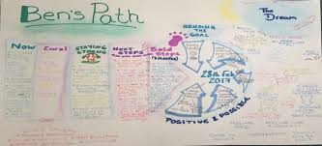
Pupil views
My
Hopes & Dreams
What’s going well?
Life would be better if…
Things I find difficult…
These people support me..
Pupil views booklets are found here:
https://westsussex.local-offer.org/information_pages/228-settings-applying-for-an-education-health-and-care-needs-assessment-ehcna-ehcp-forms-and-paperwork

Slide 12
Provision maps
A provision map needs to show clear and detailed information on the provision the child/young person needs to make progress and the cost of the provision.
Inclusive quality first teaching is an expectation for every child and must not be included.
In section 7 of the ECHNA request form there is a table to detail the current provision for the child/ young person.
You can also include you own documentation to evidence costed provision. This must show annual costs.

Slide 13
This table needs to be completed on the EHCNA request form.
Section 7 | Summary of Current Provision and Intervention
All mainstream schools, settings and colleges are provided with resources to support children/young people with additional needs, including pupils with SEN and disabilities and schools are expected to fund up to £6000 to support those with special educational needs. Please complete the table below detailing the current provision in place to support and meet the needs of the individual child/young person. Schools can include their own documentation (scanned provision map/spreadsheet etc.) to evidence the costed provision. This must show annual costs.
Cognition and Learning
*Add a new row for each intervention. To do this – click outside of the table row and you will see a line for typing. Press enter and a new row will appear. *
Intervention | Number of sessions each week | Total minutes per week | Delivered by TA, HLTA | Size of teaching group | Cost (Please ensure that for group interventions you calculate the cost per child) | Details of the impact of each intervention Impact RAG and Analysis R = No impact A = some, not sustaining G = good, and sustaining
Outcome(s) child is working toward(s) for the next academic year

Slide 14
You can also provide your own costed provision map. Example for key stage 1.
Day | Session time/type | Break | Session time/type | Lunch | Session time/type | Hours | Cost
Mon | 8.45 - 9.15 1:1 Learning mentor anxiety session 09.15 - 10.15 TA small group 1:4 literacy support to aid speech and language and concentration needs - support to focus on task | 15 mins. 1:1 learning mentor anxiety and social skills | 10.45 - 11.45 classroom 1:1 TA support for maths work differentiated by Class Teacher | 30 mins learning mentor anxiety and social skills | 13.00 - 13.30 Speech and language programme 1:1 with TA 1400 - 15.00 In class small group 1:5 TA support Topic | 4.75 | TA 2 hrs @ £11.51 per hour - £23.02 TA 0.5 hrs. @ £11.51 divided by 5 - £2.3 TA 1 hr. @ £11.51 divided by 4 - £2.88 LM 0.75 hrs. @ £13.07 per hour £9.80 Total £38

Slide 15
Information needed on a provision map
Who to include on the provision map.
Someone who is employed additionally to support the pupil e.g. TA, Learning Mentor.
Specialist Teacher e.g. Learning Support Teacher
NOT the class teacher
(The exception being that the Class Teacher would be expected to work with that pupil/group equally with other pupils therefore if a TA is employed for the pupil but supporting others to enable the Teacher to do this then the cost for the TA is included. Make sure you explain this on the PM)
NOT the class TA
NOT the SENCO as their salary is irrespective of whether that pupil is in the school or not.
You can include those on the Not list to show what they are doing to support but you cannot include them in the costing.

Slide 16
What strategies and interventions are being implemented?
How do these relate to specialist advice given?
How do these relate to the expected outcomes?
When is the support needed?
Don’t forget to total the time for each day and week.
How many children/young people is the provision for?
1:1
Small group (state how many e.g. 1:5)
Large group (state how many)
Whole class
.

Slide 17
Calculating the costs on your provision map
You may need to speak to your business manager to find out the costs of the support you are providing.
Support costs are generally calculated by the local authority using the following gradings as a guide:
SSA (grade 4 point 15) this is the level that we would expect an SSA to be appointed at.
SSA with specialist qualifications e.g. Braille (grade 5 point 19)
Specialist teacher £30 per hour.
Additional funding in special schools and SSCs is based on the following rates;
SSA (grade 6 point 22)
Specialist teacher – approximately £30 per hour (dependent on actual salary point, this could be £34+).

Slide 18
Section 3
How to submit an EHCNA request
What happens next?
Notes:
Adapted layout

Slide 19
Top Tips
Ensure documents are the most recent and relevant.
Include your views when responding to parental request.
Ensure pupil work is relevant and annotated where appropriate.
Match information to the guidance and criteria for ECHNA requests.
Except in exceptional circumstances, do not wait until year 6 or a year before transition to apply.
It is expected that you will have discussed the supporting documents with parents, or the young person, prior to submitting them. Good practice dictates a joined up approach to a request of this type.

Slide 20
How do you submit the request?
Settings can apply by emailing the required forms to the SEN Assessment Team.
The required EHCNA request form and EHCNA medical questionnaire can be downloaded from this page.
https://schools.local-offer.org/send-toolkit/send/education-health-and-care-needs-assessment/
Please email these completed forms, along with other relevant evidence described on the final page of the request form, to EHCNARequest@westsussex.gov.uk

Slide 21
What happens next?
Immediate email response to say request received
Letter to parents informing to be discussed at panel
One of 2 decisions:
RTA – Refusal to Assess
EHCNA AGREED

Slide 22
RTA – Refusal to Assess
What happens next if the Local Authority decide not to carry out an EHC needs assessment?
It is our aim to support families and schools with what they can do next to help a child/young person if there is a refusal to assess. It is important that parents and schools fully understand why the local authority has reached this decision.
Once a refusal to assess decision has been made, the Planning Co-ordinator will call parents advising them of the decision and provide reasons as to why this was made. Following this a letter will be sent out to parents and school confirming the decision.

Slide 23
RTA – Refusal to Assess
The Special Educational Needs and Assessment Team (SENAT) can provide support to parents and schools regarding the refusal to assess decision which could include:
A further conversation with the Planning Coordinator regarding the decision.
Requesting a meeting with a Special Needs Officer (SNO) who will look into the case and be able to suggest next steps. For example, advice around the graduated approach, OAIP (Ordinarily Available Inclusive Practice), referrals to the appropriate outside agencies and transition support.
The SNO can provide information to parents regarding what SEN Support can look like in a nursery, school or college setting.
Support sessions for SENCOs new to the role or the EHCNA application process.
The SNO can also provide support to schools regarding the evidence they will need to gather if a future request is to be considered after advice has been implemented over time and if expected progress is not seen.

Slide 24
The following cases are an example of how SENAT have supported families and settings after a refusal.
Primary School EHCNA request.
Refusal to assess made by SENAT.
Parent informed of the decision by a Planning Coordinator.
School contacts Planning Coordinator to discuss further.
Referral to SNO (Special Needs Officer).
SNO meets with SENCO to discuss the refusal in more detail.
Next steps for the child discussed and agreed. SENCO and class teacher to implement plan using the graduated approach.
Meeting with parents, school and SNO to discuss plan.
Referral made to outside agency for advice.
Plan implemented over time, including recommendations from an outside agency). Minimal progress seen.
New referral for an EHCNA made with further evidence based on 2 cycles of the graduated approach.
EHCNA agreed.

Slide 25
Secondary School Parental EHCNA request
Parental EHCNA request.
Refusal to assess made by SENAT.
Parent informed of the decision by a Planning Coordinator.
SNO contacts parent to discuss the decision as directed by panel.
Child has a diagnosis of ASC and has recently transitioned to secondary school. He attended a week’s summer school as part of his transition and is doing very well.
School is supporting him under SEN support, and they are happy with the progress he is making.
Quality first teaching and Ordinarily Available Inclusive Practice discussed with parent.
Parent was not aware of what school are able to put in place without the need for an EHC plan.
Meeting held with school, parent and SNO in the Autumn term to discuss support for child.
Child continues to do well in his new school.

Slide 26
Post 16 College
Parental EHCNA request.
Refusal to assess made by SENAT.
Parent informed of the decision by a Planning Coordinator.
Referral made to PfA (Preparing for adulthood) SNO.
PfA SNO met with the young person and parent in the summer holidays.
Worries were discussed and resources shared to help the young person with her anxiety.
A preparation for adulthood plan was also shared for the young person and parent to begin to think about together.
Ways to prepare for starting college were discussed including developing friendships and travel.
Young person said she was looking forward to her courses and would be studying Business, I.T and Photography.
PfA SNO met with college prior to the beginning of term, a plan was put in place for the young person to have a key member of staff to meet on the first day as well as being introduced to the pastoral team.
Young person has made a positive start at college.

Slide 27
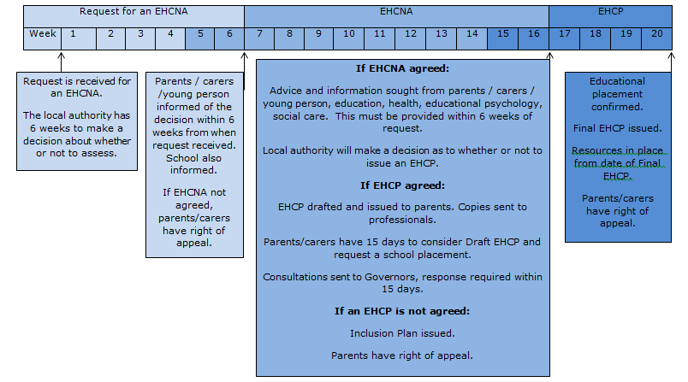
PROCESS FOR TIMING OF ASSESSMENTS

Slide 28
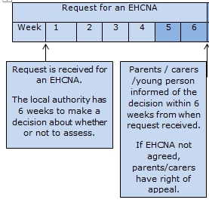
PROCESS FOR TIMING OF ASSESSMENTS
Weeks 1 - 6

Slide 29
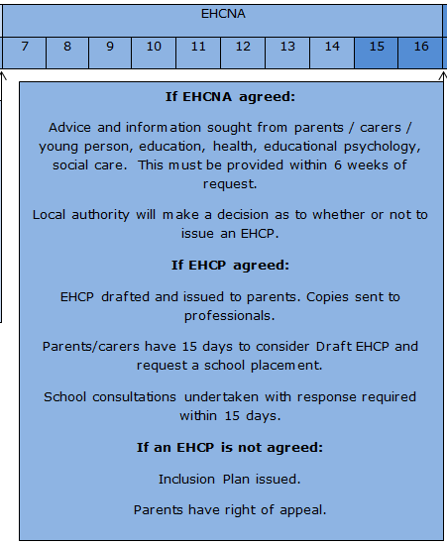
PROCESS FOR TIMING
OF ASSESSMENTS
Week 7 - 16

Slide 30
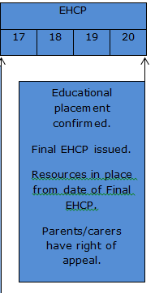
PROCESS FOR TIMING OF ASSESSMENTS
Week 17 - 20

Slide 31
Thank you
We hope you have found this presentation helpful.
Please take a look at the Annual Review and Funding training too!

