Slide 1
Education Health and Care Plans (EHCP)
Special Needs Officers
Special Educational Needs Assessment Team (SENAT)
Spring 2022

Slide 2
Aims
This document has been designed as a reference guide to inform schools/SENCOs to:
Understand the purpose of an Education Health and Care Plan (EHCP)
Have an overview of the Education, Health and Care Needs Assessment process
Understand the content of an EHCP document
Have an overview of the processes around maintaining the EHCP and what school responsibilities are
Know who to contact within SENAT regarding queries relating to EHCPs

Slide 3
Purpose of an EHCP?
The SEND Code of Practice (9.2) states:
“The purpose of an EHC plan is to make special educational provision to meet the special educational needs of the child or young person, to secure the best possible outcomes for them across education, health and social care and, as they get older, prepare them for adulthood.”
An EHCP:
Is a legal document written by the Local Authority (LA) to support children and young people (CYP) between the ages of 0-25 who need a high level of support
Records the views, interests and aspirations of parents and CYP
Describes the CYP special educational needs and health and social care needs
Establishes outcomes based on CYPs needs and aspirations
Specifies provision required to meet the CYPs needs and support achievement of outcomes
Gives parents the option of a wider range of provision

Slide 4
SEN Support and Education Health and Care Needs Assessments (EHCNAs) SEND Code of Practice, Section 6 and 9, Children and Families Act 2014, The Equality Act 2010, The Care Act 2014, Chronically Sick and Disabled Persons Act 1970, Children Act 1989, SEND Regulations 2014
Most children and young people with special educational needs or disabilities will have their needs met through effective use of resources already available in their mainstream setting
The West Sussex ‘Ordinarily Available Inclusive Practice’ (OAIP) guide provides useful information regarding how resources can be used to deliver effective provision as part of high quality teaching and inclusive practice
Where a child or young person is not making expected progress and is identified as likely to need regular support that is additional to and different from their peers, the graduated approach cycle ‘assess, plan, do, review’ should be followed to ensure appropriate and effective provision is put in place through SEN Support

Slide 5
SEN Support and Education Health and Care Needs Assessments (EHCNAs) SEND Code of Practice, Section 6 and 9, Children and Families Act 2014, The Equality Act 2010, The Care Act 2014, Chronically Sick and Disabled Persons Act 1970, Children Act 1989, SEND Regulations 2014
If progress is not being made despite additional SEN Support, a request for an Education Health and Care Needs Assessment (EHCNA) can be considered. Please see the link at the end of this PowerPoint for the Local Offer page which gives information regarding applying for an EHCNA. Please note this process changed in December 2021.
If an EHCNA is agreed, SENAT need to determine whether a child/young person requires special educational provision in accordance with an EHCP by week 16. A Final EHCP should be issued by week by week 20.
An EHCP should be viewed as a continuation of planning and support
that is already in place by the educational setting.

Slide 6
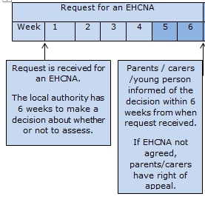
Timing of Assessments Weeks 1 - 6
When an EHCNA request is received, SENAT have 6 weeks in order to make a decision about whether or not to carry out an EHCNA. Parents, carers and school are informed of the decision. If not agreed, parents will have a right of appeal.
If parents have submitted the request, the educational setting will be asked to provide their information within 2 weeks. Ideally the educational setting will already be aware of the request through close liaison with parents and will have most of the information to hand if the CYP has been supported through SEN Support.
School are required to submit their information via the email address as if they were making the initial request.

Slide 7
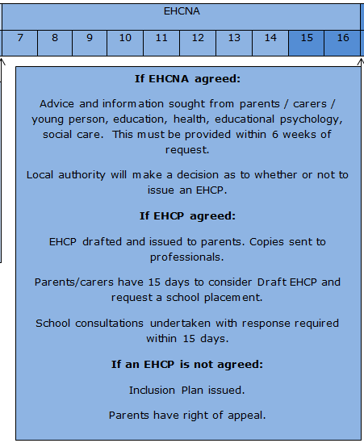
TIMING OF ASSESSMENTS Week 7 - 16
If an EHCNA is agreed advice is sought from parents/carers, CYP, educational setting, Educational Psychology Service, health and social care.
An EHCNA will not always lead to an EHCP. SENAT will make a decision about whether to issue a Draft EHCP around week 16. If agreed, the Draft EHCP will be sent to parents/carers/CYP with copies to professionals. Parents have 15 days to consider and comment if needs be. Parents also have 15 days to request a school placement.
The Draft EHCP and Governors Consultation is sent to current and prospective placements who also have 15 days to respond regarding meeting the CYP’s needs as set out in the Draft EHCP. SENCOs should be aware that the copy for the educational setting is routinely sent to the Headteacher.
If an EHCP is not agreed an Inclusion Plan is issued and parents have a right of appeal.

Slide 8
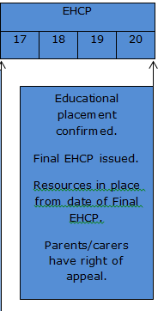
Timing of Assessments
Week 17 - 20
Educational placement is confirmed and the Final EHCP is issued. Any educational resources are allocated from the date of the Final EHCP. Parents also have a right of appeal at this point should they wish to use it.

Slide 9
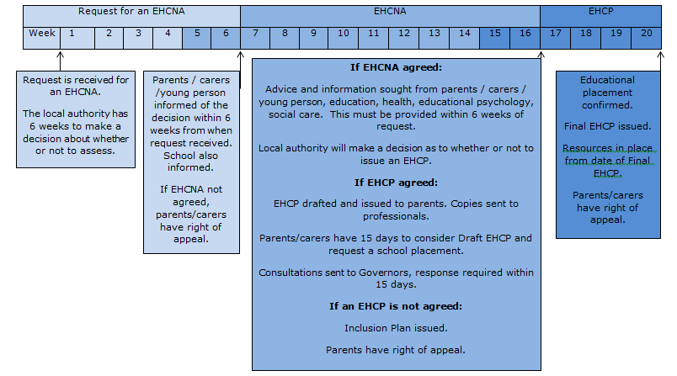
Process for Timing of Assessments
This diagram shows the EHCNA process from start to finish. Further information regarding this and how to apply for an EHCNA request can be found in our ‘Requesting an EHCNA’ training PowerPoint on Tools for Schools.

Slide 10
What’s in an EHCP?
The SEND Code of Practice stipulates the sections that
must be included in an EHCP and how they are labelled
The specific format of an EHCP is agreed locally, by the
Local Authority
The sections in an EHCP are as follows:
Section A records the views, interests and aspirations of the CYP and/or their parents or carers. A West Sussex (WS) EHCP describes the CYP’s story, what others admire about them, what is important to and for them, how best to communicate with them and the CYP’s and parent/carers aspirations for the future. From Yr 8 onwards this section also includes information in relation to Preparation for Adulthood (PfA). It is important that the pupil views and parent/carer views are gathered and recorded at each Annual Review so that this information remains up to date and can be used to amend the EHCP when needed
Section B describes the CYP’s special educational needs (SEN). In a WS EHCP the primary area of need is recorded at the beginning of this section and there is a summary of strengths and needs under each separate area of need. This information is taken mainly from professional reports

Slide 11
What’s in an EHCP? (Cont….)
Section C and G describe the CYP’s health needs related to their SEN and any health provision required to meet those needs unless considered to educate or train in which case this would be included in Section F
Section D, H1 and H2 describe the CYP’s social care needs related to their SEN or disability and any social care provision required to meet those needs
Section E sets out a list of the outcomes sought for the CYP, these are taken from reports provided by professionals. If at the Annual Review it is felt these have been met or need amending, new ones can be suggested and recorded on the Annual Review Setting and Meeting Report

Slide 12
What’s in an EHCP? (cont…)
Section F sets out the provisions sought for the CYP to meet the outcomes in Section E and the resources for those provisions. This information is also taken from the professional reports and if changes are requested to this section a report from an appropriate professional would need to be provided to evidence this in order for the changes to be considered by SENAT
Section I states the name and type of educational setting – this is only stated in the Final EHCP and not the Draft
Section J provides information on any Personal Budget arrangements used to secure provision in the EHCP
Section K is the appendices to the EHCP and gives a list of the advice and information gathered from the EHCNA and also any further amended EHCPs
The Signature box at the end of the EHCP is completed when the final EHCP is issued. It provides the name of the Planning Co-Ordinator (PC) who wrote the EHCP but this may not necessarily be your school’s PC. It also indicates when the next annual review meeting is due, within 12 months.

Slide 13
Allocation of Resources
The EHCP briefly describes the funding arrangements for mainstream or specialist placements
Funding is allocated from the date of the Final EHCP
For CYP in mainstream schools, it is expected that the school provides the pupil-led factor plus the first £6,000 of support from within the Notional SEN Budget. The LA may also ‘top up’ this funding in order to meet the provision in the EHCP through:
an Individually Assigned Resource (IAR or SEN Supplement) which amounts to £3,356 (this figure usually changes annually) and enables the school to provide additional support across the school week. This is allocated by SENAT from the High Needs Block and should be reviewed as part of the Annual Review.
A Personal Supplement for children who require a higher level of support. This is also allocated from the high needs block by SENAT and is also subject to Annual Review
Please see the link to the SEN Funding in Schools at the end of this PowerPoint.

Slide 14
Allocation of Resources
Personal Budgets. The SEND Code of Practice States:
“A Personal Budget is an amount of money identified by the local authority to deliver provision set out in an EHC plan where the parent or young person is involved in securing that provision.”
Parents or young people with an EHCP can ask for a Personal Budget when a Draft is issued or at an Annual Review. Details of any allocated education, health or social care personal budgets are included in Section J of the EHCP.

Slide 15
Monitoring and Review of an EHCP
The educational setting should meet with the CYP and parent/carers to set up an Individual Learning Plan (ILP) in order to implement the EHCP. The ILP should include short-term outcomes and arrangements for reviewing these termly. These short-term targets should be the smaller steps towards the yearly outcomes identified at the Annual Review and the longer term outcomes in the EHCP
The EHCP must be reviewed as a minimum every 12 months. The first review must be held within 12 months of the date when the EHCP was finalised, and then within 12 months of any previous review. Progress towards meeting the outcomes in the EHCP must be considered fully at each annual review and outcomes for the coming year should be set to inform the short-term outcomes in the ILP
The LA must decide whether to keep the plan as it is, make changes, or cease to maintain it within 4 weeks of the Annual Review meeting. Parents have a right of appeal following an Annual Review
Please see the link for Annual Reviews paperwork at the end of this PowerPoint for further information.

Slide 16
Amending EHCPs
EHCPs are amended at the following times:
Age phase transfer, for example, primary to secondary
When there is a change of placement
When there is significant additional information e.g. a new diagnosis or change in provision
When an EHCP is amended a Draft Amended EHCP is sent to parents and professionals with proposed changes clearly indicated. Parents have 15 days to respond to the Draft Amended document with any comments. SENCOs should be aware that the copy for the educational setting is routinely sent to the Headteacher.
EHCPs are not automatically amended after each Annual Review . The Annual Review serves as an update to keep the information current and should be read alongside the EHCP. New or amended outcomes can be suggested for consideration by SENAT at the Annual Review where outcomes are achieved or out of date and recorded in the meeting report

Slide 17
Governor Consultations
When parents request a change of setting SENAT are required to consult the Governors of the proposed setting to ask how they will meet the needs of the CYP as set out in the EHCP. A copy of the EHCP, appendices and/or last Annual Review are sent with the consultation
When settings receive a Governor’s Consultation and have concerns, it is an opportunity for the educational setting to state what additional resources they would need in order to meet needs
Educational settings have 15 days to respond to a Governor’s Consultation
Where a parent/carer requests a place in a specialist setting, SENAT will also need to consult mainstream schools to seek views in order to make informed decisions regarding placement

Slide 18
Ceasing an EHCP
An EHCP can be ceased when:
It is felt that the CYP no longer needs the EHCP as they have achieved their outcomes and no longer need the SEN provision specified. An Annual Review should be held to request the ceasing of an EHCP and the LA will then consult the parent and/or CYP and the educational setting to inform them that they are considering this and to seek their views. The LA will then make a decision as to whether or not to cease the EHCP
The LA is no longer responsible for the CYP, for example,
when they gain employment or enter higher education

Slide 19
Who to contact?
Who to contact regarding queries with EHCPs:
The first point of contact is the Planning Co-ordinator for your school. You can find this information at the end of these slides
You can also talk to your SNO

Slide 20
Just a few reminders….
An EHCP and the process for monitoring and reviewing should hold the CYP and their wishes and feelings at the centre of the process
Most CYP will have their needs met through effective use of resources without the need for an EHCP
An EHCP should be viewed as a continuation of planning and support
Schools are expected to make reasonable adjustments to provision for children with EHCPs
For parent EHCNA requests, school have 2 weeks to submit their information
Funding is allocated to the educational setting from the date of the Final EHCP
Details of funding can be provided by the Planning Co-Ordinator
Monitoring/review of an EHCP is through the ILP process and the Annual Review
EHCPs are not automatically amended after each Annual Review
The Governor’s Consultation is an opportunity for school to consider what the LA and school or setting can do together to remove barriers to learning and forms a robust response to any legal challenges. Important: ‘Suitability’ cannot be used as a reason to deny a child or young person mainstream education.
Significant changes in circumstances should be discussed at Annual Review
SENCOs should be aware that the copy EHCP for the educational setting is routinely sent to the Headteacher.

Slide 21
Links
Code of Practice
https://www.gov.uk/government/publications/send-code-of-practice-0-to-25
Tools for Schools - other SNO training available – visit Team around the Child, Training Page and then the Special Needs Officers’ page
https://schools.local-offer.org/
Ordinarily Available Inclusive Practice
https://schools.local-offer.org/inclusion/ordinarily-available-inclusive-practice/
SEN Funding in Schools
https://westsussex.local-offer.org/information_pages/171-special-education-needs-funding-in-schools
Annual Reviews/Paperwork
https://westsussex.local-offer.org/information_pages/495-annual-reviews-paperwork-for-settings

Slide 22
Links
Applying for a needs assessment
Education, Health and Care Needs Assessment | Tools for schools (local-offer.org)
Special Educational Needs Funding in Schools – Local Offer https://westsussex.local-offer.org/information_pages/171-special-education-needs-funding-in-schools
Personal Budgets – Local Offer
https://westsussex.local-offer.org/informat ion_pages/43-personal-budgets
SEND Information, Advice and Support (SENDIAS)
https://westsussexsendias.org/

Slide 23
Contacts
SENAT Contact details:
Claire Rimmer Claire.rimmer@westsussex.gov.uk - Oversees work associated with requests for EHC needs assessments as well as undertaking reviewing and monitoring duties.
Preparation for Adulthood (PfA) SNO: Jennie May – jennie.may@westsussex.gov.uk
School’s first point of contact will be the Planning Co-Ordinator (PC) allocated to your school. Please email the Team Inbox or your area SNO if you are unsure who your named Planning Co-Ordinator is.
North Team Inbox: SENAT.north@westsussex.gov.uk
Special Needs Officers (SNOs) North Team:
Sharon Smith - sharon.smith@westsussex.gov.uk
Kim Heden - kim.heden@westsussex.gov.uk
Elektra Robinson – elektra.robinson@westsussex.gov.uk
South Team Inbox: SENAT.south@westsussex.gov.uk
Special Needs Officers (SNOs) South Team:
Emma Spurle – emma.spurle@westsussex.gov.uk
Sam Mainwaring - sam.mainwaring@westsussex.gov.uk
Claire Fowler – claire.fowler@westsussex.gov.uk

