Slide 1
Recovery Curriculum
“The curriculum is the servant of the child not the master”
Professor Barry Carpenter July 2020

Slide 2
Recovery Curriculum
What are they experiencing?

Slide 3
Recovery Curriculum
There have been areas of loss identified. What do you think they are?

Slide 4
Recovery Curriculum
Loss
Routine
Structure
Friendship
Opportunity
Freedom

Slide 5
Recovery Curriculum
This has led to psychological consequences and symptoms.
List one.

Slide 6
Recovery Curriculum
Consequences
Bereavement
Attachment
Anxiety
Trauma

Slide 7
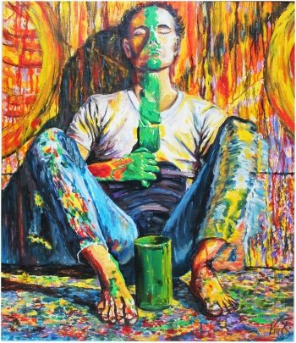
Recovery Curriculum
Healing & Rebuilding

Slide 8
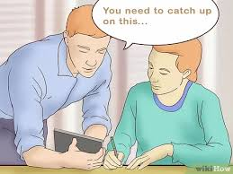
Recovery Curriculum
Consequences
Bereavement
Attachment
Anxiety
Trauma
+
=

Slide 9
Recovery Curriculum

Slide 10
Recovery Curriculum
5 Levers

Slide 11
Recovery Curriculum
Lever 1:
Relationships

Slide 12
Lever 2:
Community

Slide 13
Recovery Curriculum
Lever 3:
Transparent Curriculum

Slide 14
Recovery Curriculum
Lever 4:
Metacognition

Slide 15
Recovery Curriculum
Lever 5:
Space

Slide 16
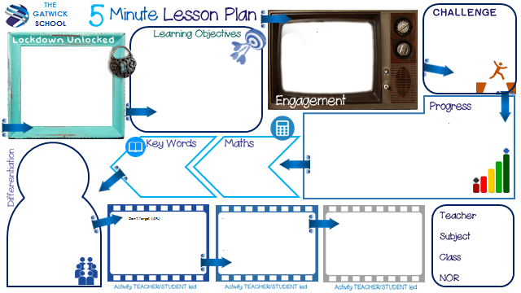

Slide 17
Recovery Curriculum
https://www.evidenceforlearning.net/recoverycurriculum

